Slide 1






Inspire your Business
SunJewels – SAP S/4 HANA Conversion
Castaliaz Technologies Private Limited

Slide 2

Agenda
1
Background
Castaliaz SAP S/4HANA Migration Overview & Approach
2
3
Scope and Delivery Model
Why Castaliaz
4
5
Next Steps

Slide 3
Table of Contents
1
Background
Castaliaz SAP S/4HANA Migration Approach
2
3
Scope and Delivery Model
Why Castaliaz
4
5
Next Steps

Slide 4
Castaliaz is pleased to respond to Client’s RFP and to offer our professional services to support the migration to SAP S/4HANA
Executive summary
Sunjewels intends to deploy SAP S/4HANA 1709.
Sunjewels plans to migrate its current SAP ECC system to S/4HANA system along with lot of functional improvements, process automation and system enhancements.
Based on our Presence in Discreet Manufacturing Industry, SAP Certified Solution for Discreet Manufacturing industries and SAP Deployment Methodology “Activate” as well as the experience and skills of our consultants we will minimise the project risks of Sunjewels Private Limited and enable Sunjewels benefits in IT and business in a very fast way
We will bring in our Best Practice Discreet Manufacturing in Jewellery processes and accelerators for the project and combine it with our Onshore and Offshore approach leveraging both local onsite and offshore capabilities
We are fully committed to support Sunjewels in achieving their objectives and goals as a long term partner with Castaliaz Executive Management Sponsorship
  Our Proposed Solution
Faster ROI: By leveraging our experiences and preconfigured assets and methods we see a total timeframe of 8 months for doing the SAP S/4HANA Implementation
Faster delivery: The timeframe will be reduced to the final Go-Live in 6 Months and 2 Months post Go Live support.
Reduced risk: We have done this many times before and therefore are able to secure the integration within the local and international Client business and IT landscape as well
  Project Approach & Timeline

Slide 5
Table of Contents
1
Background
Castaliaz SAP S/4HANA Migration Overview & Approach
2
3
Delivery Model
Why Castaliaz
4
5
Next Steps

Slide 6
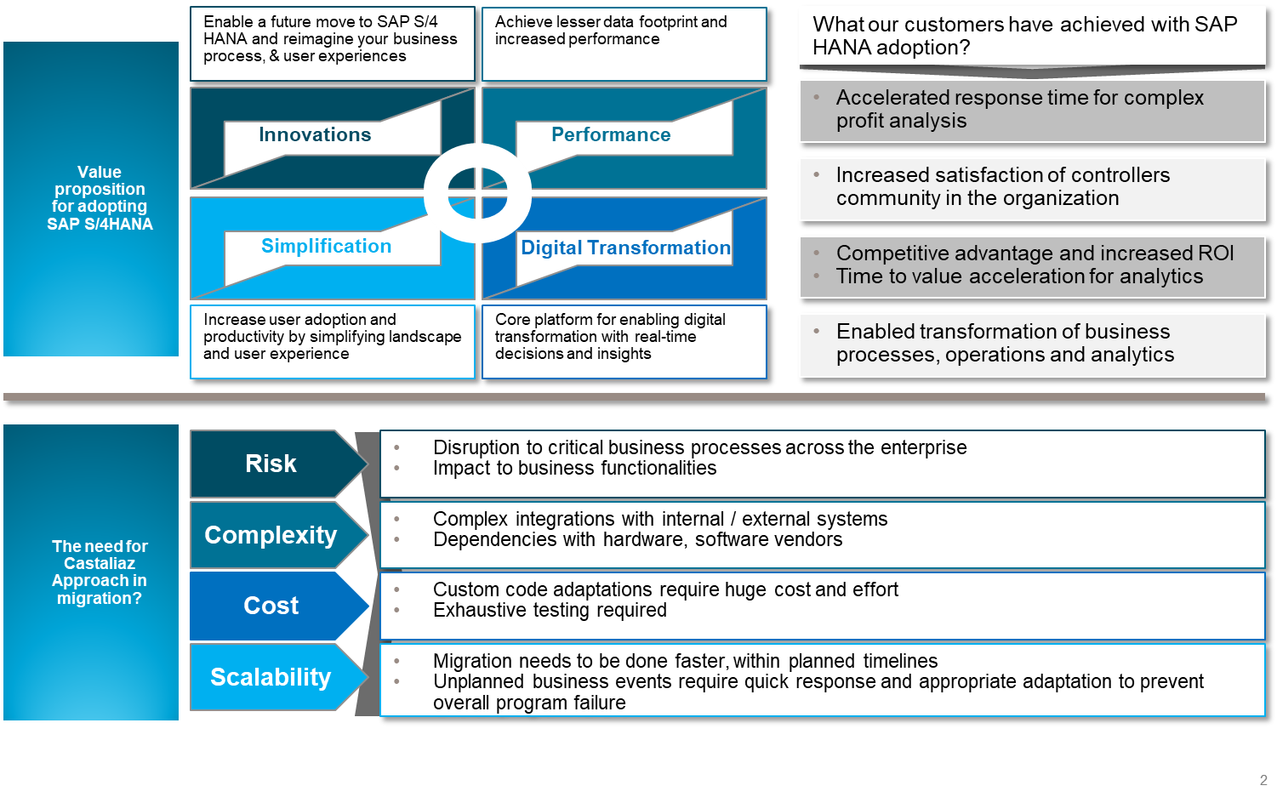
Castaliaz Executive Overview

Slide 7
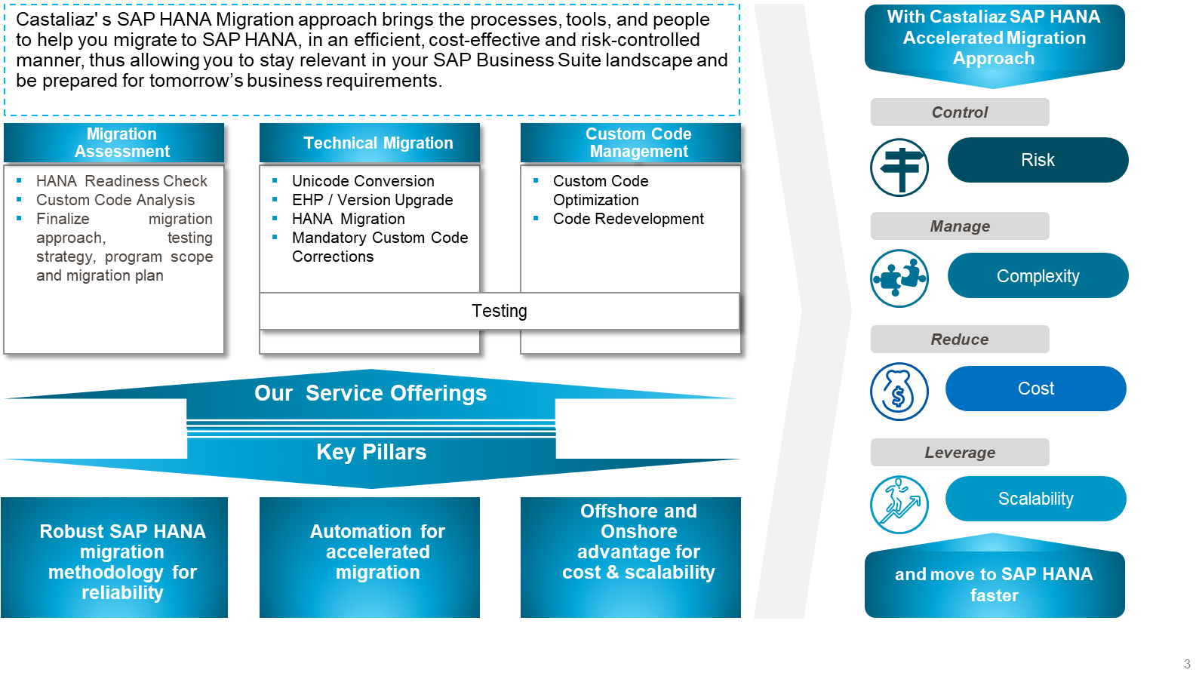
Castaliaz Executive Overview…
Introduction to S4H Migration Castaliaz way (1)

Slide 8
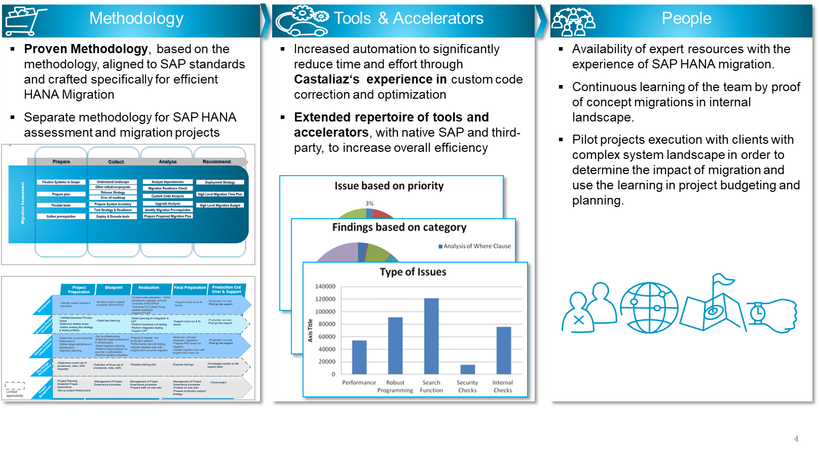
Castaliaz Executive Overview…
Introduction to S4H Migration Castaliaz way(2)

Slide 9
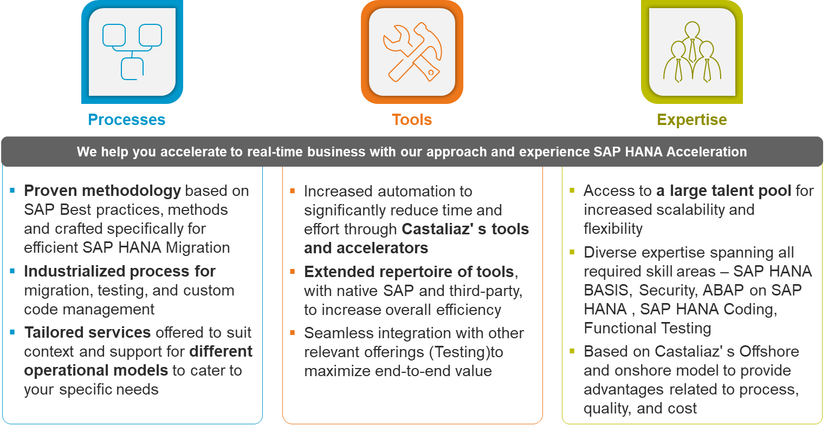
How Castaliaz can help you Accelerate to SAP S/4HANA

Slide 10
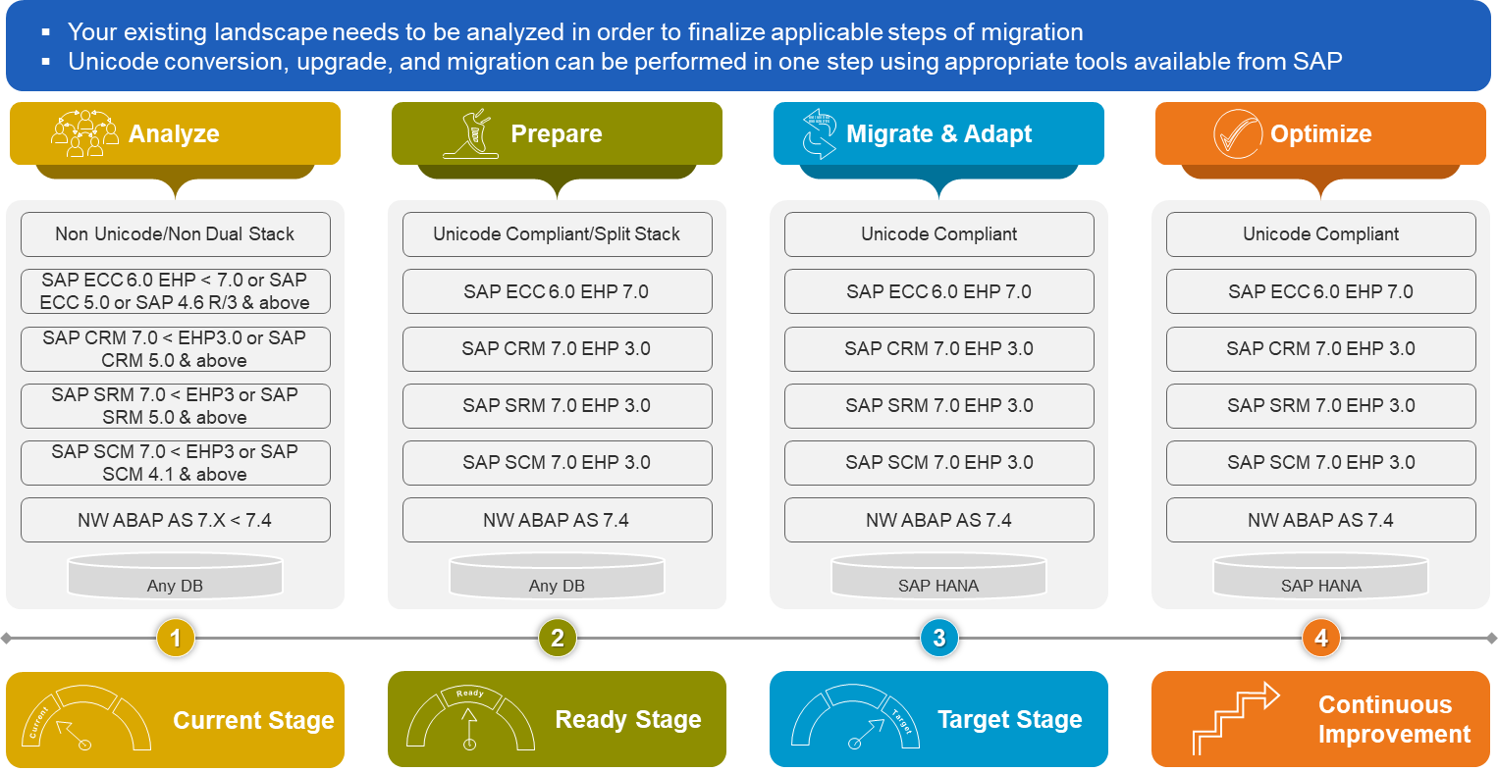
Your Migration Journey

Slide 11
1
Background
Castaliaz SAP S/4HANA Migration Overview & Approach
2
3
Scope and Delivery Model
Why Castaliaz
4
5
Next Steps

Slide 12
Engagement Scope
Organization, Location, Business
Organization Scope
Location Scope
Line of Business
SunJewels Private Limited
Corporate Office:
  Mumbai
Factory Locations
  Seepz
US Office
  NY
Manufacturing & Distribution
Gold & Diamond Jewellery

Slide 13
Engagement Scope
Functional + Technical Scope
Functional Scope
Technical Scope
Development Scope
Financial Accounting
Controlling
Sales & Distribution
Materials Management
Production Planning
Quality Management
NetWeaver Scope – S/4 HANA 1709
Migration/Conversion to S/4 HANA Development system
Migration/Conversion to S/4 HANA Quality system
Migration/Conversion to S/4 HANA Production system
Installation of FIORI Server
Installation of Solution Manger 7.2
Code Conversion and Optimization of ABAP Developments (WRICEF) – To be done by SunJewels and Castaliaz Team
Activation of Standard Fiori apps

Slide 14
Engagement Scope
Functional Enhancement
Multi Purpose Ledger
Additional Metal/Component in BOM
Dual Quantity to be updated on Real Time
Relook at Master Data, BOM, Batch design
Change in Inventory Valuation
Change in Value Addition
Rebate and Scale Wise Pricing
Quotation Generation for Sales Team
Material Ledger for Stock Accounting
Improvement in Financial Accounting
Introduction of New Metals & its impact on processes
Proper Implementation and Utilization of COPA
Capacity Planning and Scheduling
Automation in Finance Processes
Implementation of INDAS
Changes to existing Org Structure
Implementation of SAP for US Entity
Functional Enhancement is over and above the existing Processes
Can be achieved using Catch Weight Solution

Slide 15
Technical Scope
WRICEF Development
No of Objects – 25
Simple - 12
Medium - 10
Complex – 3
Code Conversion and Optimization
NetWeaver
Installation of S/4 HANA 1709 systems (DEV, QAS & PRD)
Installation of FIORI
Installation of Solution Manager 7.2
FIORI
Activation of all standard Apps (1000+)

Slide 16
Activities
# | Activities | Sub Activity
1 | Upgrade to Ehp7- ECC | Technical Upgrade
2 | S/4 Migration
 | ECC | SQL to HANA
 |  | Application migration to S/4
 | BW | SQL to HANA
 |  | Application migration to S/4
3 | FIORI | Installation and Configuration
 |  | Deployment of FIORI APPS
4 | Solution Manager | Installation and Configuration (Version 7.2)
5 | Tools for Project Management | Solution Manager or other Tool
6 | Implementation of New Requirement in S/4HANA 1709 | As per details mentioned in Functional Enhancement + Simplification in S/4HANA
7 | Listing of all existing developments | Listing of Customised Transactions Listing of Customised Reports Listing of Customised Outputs
8 | Backup strategy | To be devised based on Solution provided by Hardware Partners
9 | High Availability | To be suggested by Hardware Partners

Slide 17
Business Benefits on S/4HANA for SunJewels
# | Activities | Pain Point | Benefits on S/4HANA
1 | Dual Quantity for Diamonds | Currently there is not standard method to achieve this and hence customised development is carried out which is not a advisable solution as the change is dynamic and all scenarios cannot be built | On S/4HANA, this process can be configured using standard functionality. This will reduce the manual efforts needed to calculate and eliminate errors
2 | WIP Calculation | Currently takes a long time to process and post WIP | This process will run much faster on S/4HANA and the calculation and posting will be carried out at a tremendous speed
3 | COPA Report | Currently takes time to process records for a longer period | On S/4HANA, COPA reports will be extracted within 5 mins due to its in-memory computing technology
4 | Price Variation | Users are not able to interpret or understand due to what transaction there is an impact on price variation | With S/4HANA, material ledger will be activated which can track price changes due to a particular transaction which users can interpret easily
5 | Price Calculation in Sales Order and Invoicing | Pricing calculation is completely customised due to the nature of complex calculation. Currently lot of time is taken in processing pricing calculation in sales order and Invoices. If the Order is with large volume of Items then it takes more than 30 mins to create or change one sales order | With S/4HANA’s powerful computing speed, the pricing calculations would be carried out much faster thereby reducing the time to complete processing of transactions.
6 | Payment Approval | Currently payment approval process is not available on ECC | Approval process is available as standard in S/4
7 | Reconciliation between FI and COPA | Reconciliation will have to be carried out between FI and COPA modules to verify and match the details | In S/4, the process of reconciliation is eliminated
8 | Ease of Operations | All transactions are managed using GUI and runs only from Desktop / Laptops | All transactions can be carried out from smart devices
9 | Ease of Reporting | No Real Time Analysis available on ECC | S/4HANA provides real time analytical data for faster decision making

Slide 18

Implementation Approach
Green Field Implementation
Conversion of Existing ECC system to S/4HANA 1709

Slide 19
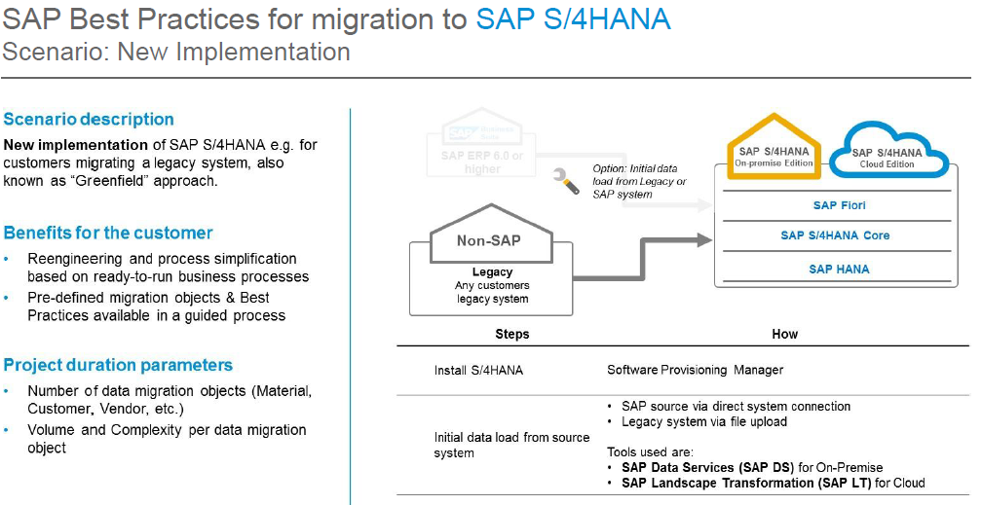
Implementation Approach
Green Field Implementation of S/4HANA

Slide 20
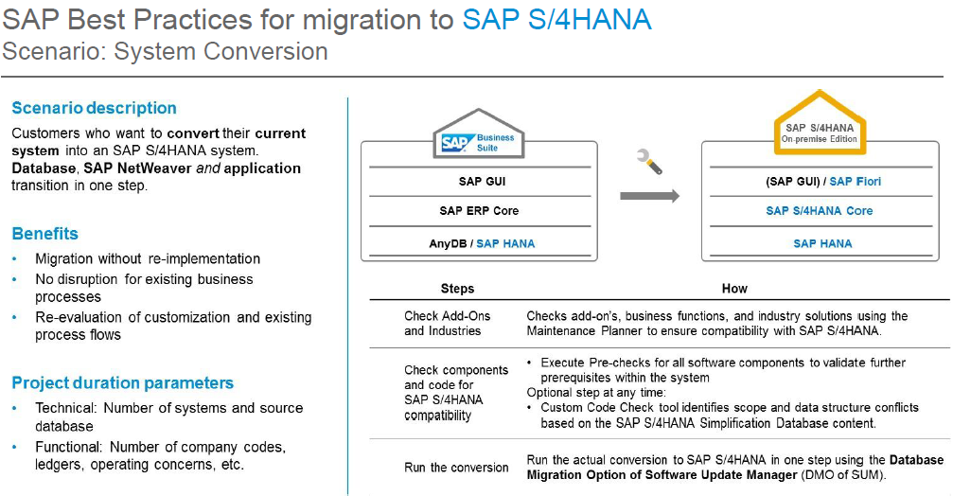
Implementation Approach
Conversion to S/4HANA

Slide 21
Castaliaz Migration Approach – RACI
Migration Assessment
Technical Migration
Optimization
Client’s Confirmation
Analyze
Prepare
Migrate
Adapt
Test
Optimize
Step 1
Step 2
Step 3
Step 4
Step 5
Step 6
Finalize scope,
Plan, WBS
Prepare the system for migration
Perform Migration
Adapt custom code for compliance
Unit Testing, IST, UAT, Performance Testing
Custom code optimization
Onshore
SAP S/4 HANA Migration Factory
Factory
Project Manager
Project Manager
Project Coordinator
Project Manager
Project Coordinator
Offshore Delivery Lead
Solution Architect
Offshore Delivery Lead
Solution Architect
Delivery Team
Delivery Team
Key Users & IS Team
Key Users & IS Team
Key Users & IS Team
Tools, Templates, Best Practices, Accelerators
Client’s Team
CastaliazTeam
Release Milestone

Slide 22
Castaliaz Migration Approach – RACI
Task | CL | PC | SA | DL
Final Statement of Work | A/R | C/I | C/I | I
Effort estimation for the Service | C/I | A/R | R | I
Schedule creation | C/I | A | R | C/I
Infrastructure availability | A/R | I | I | I
Code Adaptation/Optimization | I | I | A | R
Issue Resolution | A/R | I | C/I | C/I
Technical Unit Test | C/I | I | A | R
Functional Testing | A/R | I | C/I | C/I
Bug qualification | R | I | A/R | C/I
Bug Fixing | C/I | I | A | R
QA check | I | I | A | R
Final Delivery | I | I | A | R
Sign off | R | I | A | C/I
Overall Service Delivery | C/I | R | A/R | R
CL | Client Team
PC | Project Coordinator
SA | Solution Architect
DL | Offshore Delivery Lead/Team

Slide 23
Holistic Approach from Castaliaz for SAP Business Suite Powered by SAP S/4HANA
Benefit from Castaliaz SAP HANA Accelerated Migration Factory
Strategic Value Assessment
Value Migration
Continuous Improvements
Identify improvement areas
SAP HANA
Adoption Roadmap
Migrate & Adapt
Custom Code Optimization
(wave 2)
Time
Step 2
Step 4
Step 6
Step 1
Step 3
Step 5
Step 7
Business
Performance
SAP HANA Quick assessment
Migration Assessment
Custom Code Optimization (wave 1)

Slide 24
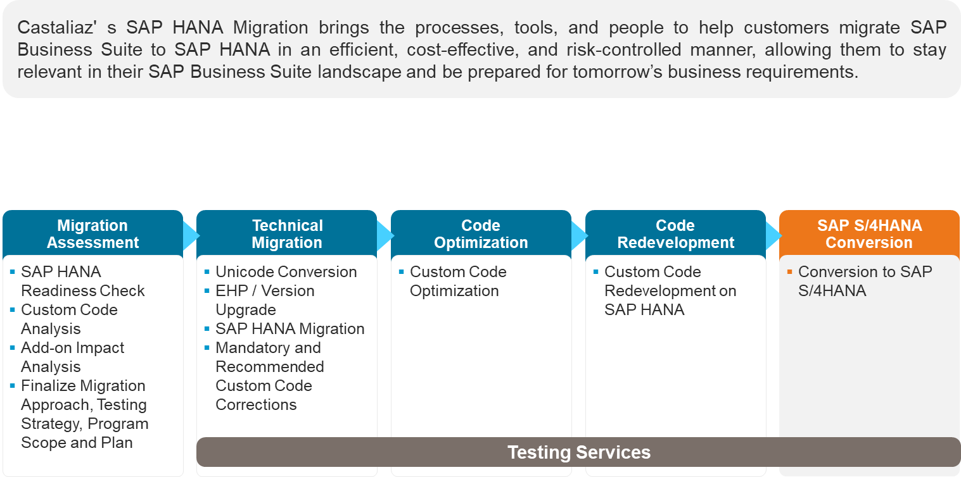
Castaliaz Migration Approach

Slide 25
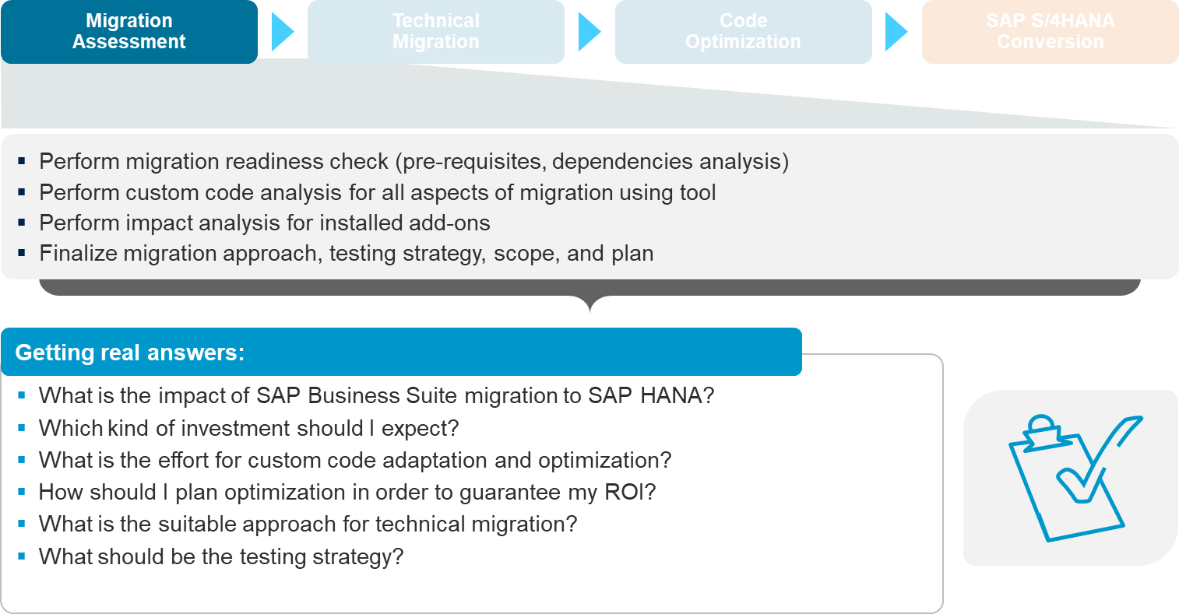
Castaliaz Migration Assesment

Slide 26
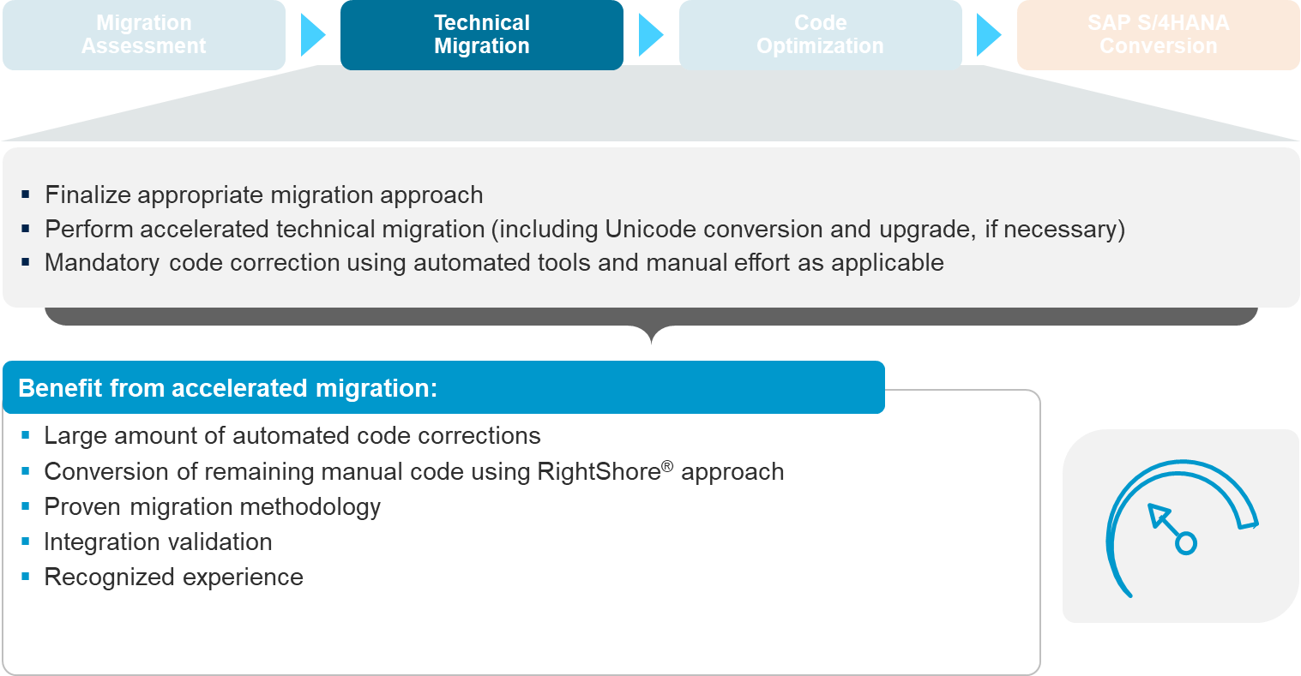
Castaliaz Technical Migration Approach

Slide 27
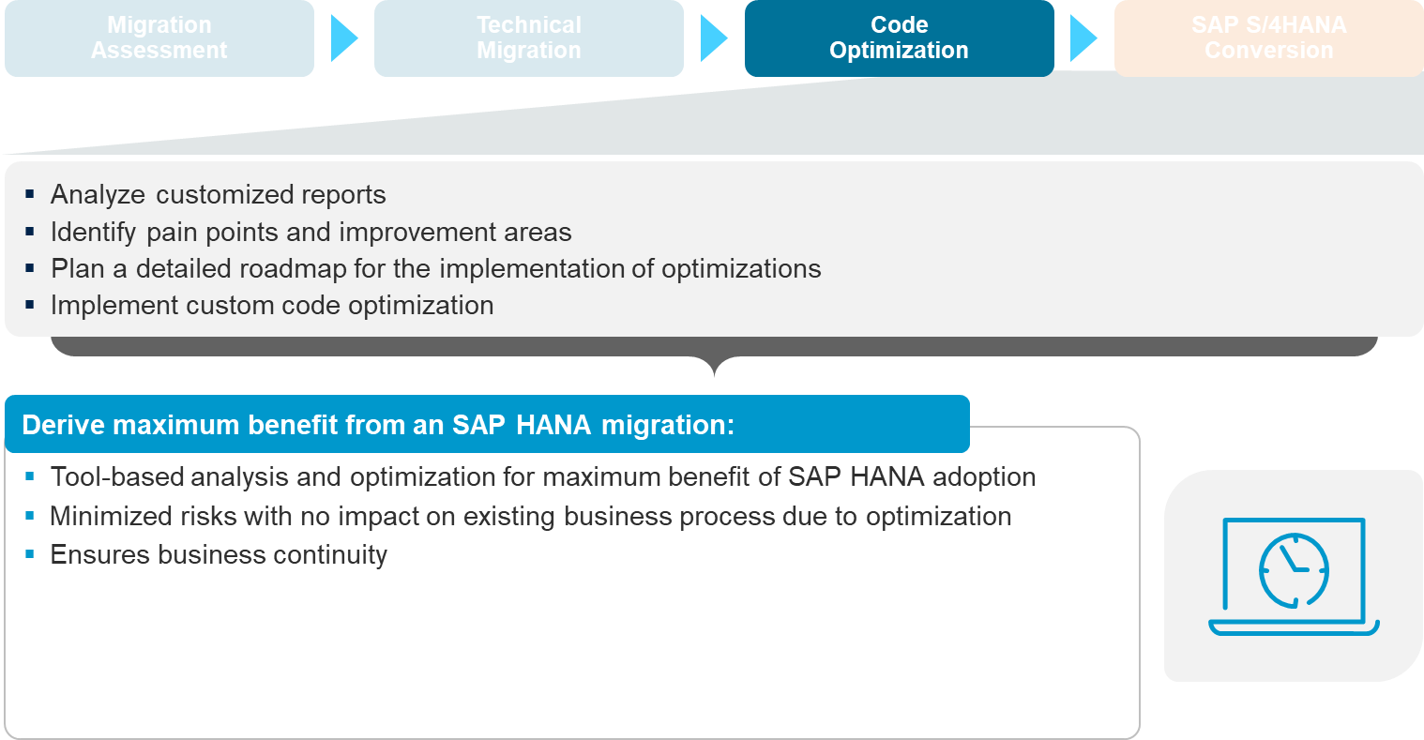
Castaliaz Code Optimization

Slide 28
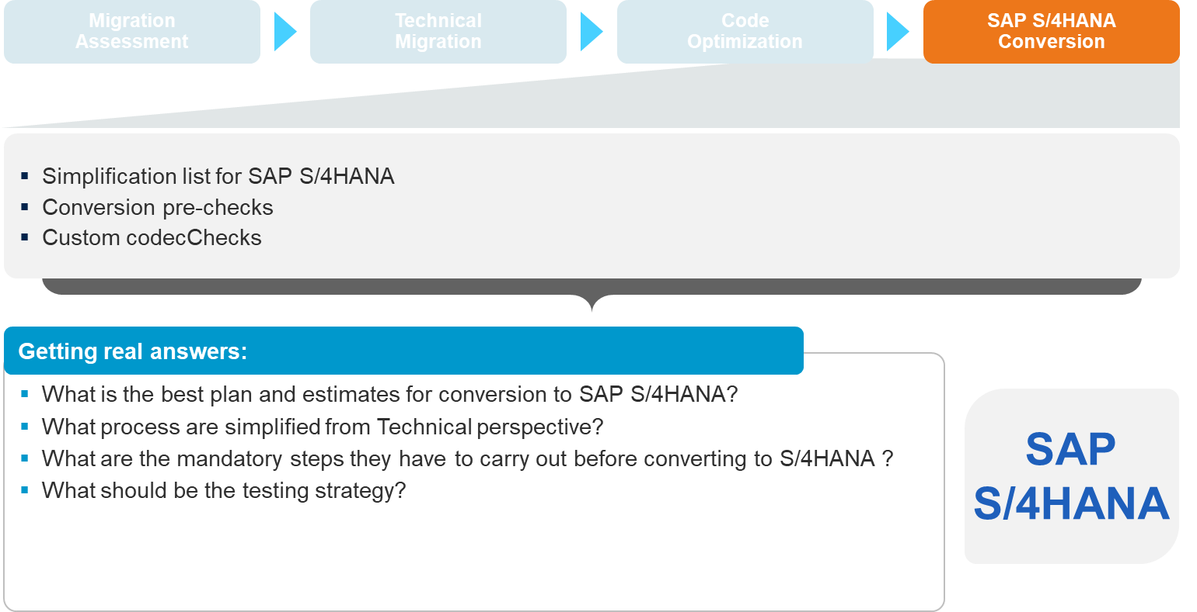
Castaliaz S/4HANA Conversion

Slide 29
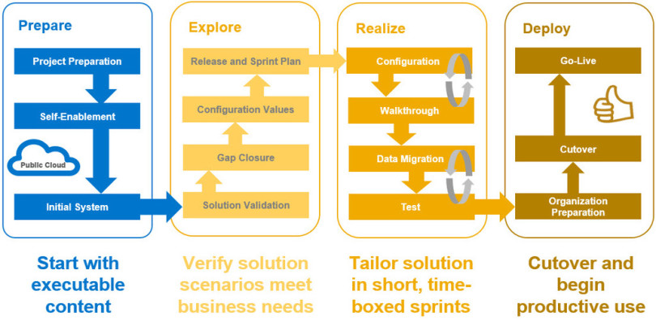
Implementation Methodology

Slide 30
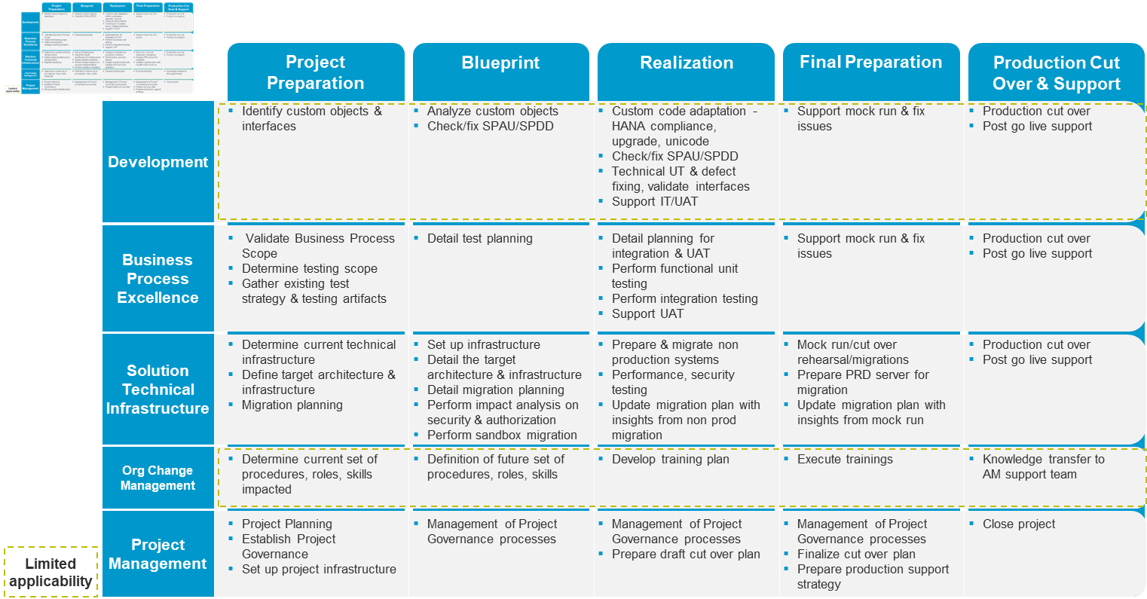
Overview of Castaliaz' s SAP HANA Migration Methodology

Slide 31
Conversion Path
Initiation

Slide 32
Conversion Path
Preparation

Slide 33
Conversion Path
Realization

Slide 34
Conversion Path
Final Preparation

Slide 35
Conversion Path
Go-Live and Support

Slide 36
Project Organization
Project Sponsor
Project Management Committee
Project Manager (Castaliaz)
Project Manager (SunJewels)
SAP FI
SAP CO
IT SAP
Finance
SunJewels Team
Castaliaz Team
SAP SD
IT Infra
Procurement
SAP MM
Basis
Sales
SAP PP
ABAP
Inventory
SAP QM
Production
SAP S/4HANA Netweaver
Quality
SAP S/4HANA ABAP

Slide 37
Project Deliverables
Project Deliverables
Project Deliverables
Project Deliverables
Project Charter
Project Plan
Project Kick-off Presentation
Business Process Master List
Fit-Gap Analysis
Code Conversion List
WRICEF List
Configuration Document
Data Migration Plan with Templates
Functional Specification Document
Technical Specification Document
Testing Strategy
Training Strategy
Cutover Strategy
End user manuals in MS-Word
S/4HANA system with processes as per BPML
Issue Tracker
User Manual – Video**
Project Closure Statement

Slide 38
Development, Testing & Training Strategy
Development Strategy
Project
ABAP Objects
Business
Requirements
Development Process
Develop
Analysis
Design
Code
Unit Test
Client Testing
Step 1
Step 2
Step 3
Step 4
Step 5
Step 6
Functional Specifications
Analysis of
Functional
Specifications
Review or Develop Design
Client
Testing
Build Code
Unit Testing
Performed at project site
Performed at Offshore Locations
Performed at project site
Client Coordinator
Offshore Coordinator
Client Coordinator
SAP Functional Experts
Remote ABAP Developers
SAP Functional Experts
End Users
End Users

Slide 39
Development, Testing & Training Strategy
Development Strategy
Step 1 – Functional Specification
Functional Specification will be documented at client site by the Functional Consultants on the project.
Importance of functional Specification document.
  This will ensure that the functional specification has the required information, based on which the Technical Specification will be documented by the developers.
  Technical Team develops a good understanding of the requirements. This will help them document the technical design document in an efficient manner.
  A functional specification with a detailed business logic will subsequently be used in documenting test cases.
Step 2 – Analysis of Functional Specification
  The Onsite Technical Team will review the Functional Specification.
  If updates are required, the Functional Specification will be passed back to the author.
  The functional specification will be signed off and all subsequent changes will be documented as a change request to document another version of the functional specification.
  Once the Functional Specification is signed off, development efforts will be estimated and assigned to the Object by the technical team.
  The signed functional specification will be assigned to onsite coordinator who will send it to Mumbai or Bangalore for development of Technical Specification.
Step 3 – Technical Design Document (Technical Specification)
  Documentation procedure will guide the developers to document the technical specification.
  Once complete the technical specification will be sent to the onsite coordinator who in turn will present the document to the technical team for review, approval and signoff.
  Technical Specification will be approved by the onsite Technical Team.
  All changes towards non-conformance to the functional specification will be documented in the review log and onsite coordinator will decide whether the changes are done onsite or sent back to offshore location.
Step – 4 Build Code
  Approved Technical specifications will be assigned by the onsite Technical team lead to the onsite coordinator.
  ABAP development will be done against an approved Technical Specification only.
  Programming standards published by client will be the guidelines for development.
  Additional information, if required, will be documented as an issue log and sent to onsite for resolution. The onsite coordinator, with help from the onsite technical team, will approach the onsite functional team for resolution and revert with the resolution to the offshore team.
  Once the code is complete it will be approved by the offshore coordinator for unit testing.

Slide 40
Development, Testing & Training Strategy
Testing Strategy
Unit Testing – verifies that individual programs execute without error, perform within set standards and are of good quality. Unit testing is an iterative process that occurs during the system development effort.
  All configuration settings
  Authorization Objects (Roles and Responsibilities / User Profiles)
  All Developments, Reports, Forms, Interfaces, User-Exits, Conversions, Components
  Integration scenarios covering end-to-end business processes
  Simulate a end-to-end business process as would be done in real-life environment
  Integration testing will be done by Customer Key User Team and sign off will be provided
Scenario Testing - executed to ensure that the transactions selected and/or any new configuration performed in SAP and system bolt-on work to support a specific business process. A single business process typically spans a number of transactions.
System Integration Testing – Final Integration Testing plan along with the testing scope and scripts will be prepared and used for integration testing of the business process scenarios encompassing multiple modules. This is the final business process test of the process before starting production. The test concludes with a message stating that the system is acceptable

Slide 41
Development, Testing & Training Strategy
Training Strategy
User Manuals
Application Consultant team shall prepare the User Manuals for each transaction as per the Business Process Master List.
Training Infrastructure
The Customer Key User Team needs to be provided with the following for completing the Training:
  Business Process Master Lists
  User Manuals
  Network Access LAN
  Access to the SAP Training Environment (login)
  Customer will Provide all Training Infrastructure for Training
Training Methodology
Application Consultant team shall train the Customer Key Users allocated for the respective function. The training content would have incorporated all the transactions related to the Business Processes that the Key User is responsible for.
Training Scope
Castaliaz will conduct on-the-job knowledge transfer sessions for the core team users based on "Train-The-Trainer" concept to address the training requirements of the power / end-users During the project, these core team users will then conduct power / end-user trainings in the Organization.
Training Sign-Off
Once the training is completed by Application Consultant team, the Customer Key User team shall sign-off the Training Phase in the prescribed document
Training sign-off is restricted to Training provided to Key User Only

Slide 42
Post Implementation Support
Support
Post Go-Live Support
Castaliaz will provide Onsite support for 2 months post Go-live for all modules
During this period team will provide support to Core team and users in operational issues and also hand holding to IT team
Hyper Care
Castaliaz recommends an Onsite and Offshore Support during the hyper care phase for a period of 2 months
  4 Weeks onsite support during the month for ABAP – Total 8 weeks onsite
  2 weeks Onsite support during the Month for all modules except ABAP – Total 4 weeks Onsite
  2 Weeks Offshore Support during the month for all modules except ABAP - Total 4 weeks Offshore
Regular Support
Post Hyper Care, Castaliaz will provide regular Offshore support which is currently being used, the man days for support will be decided mutually during the Hyper care Phase

Slide 43
Critical Success Factors
The Top management team must provide visible involvement and committed leadership to the project.
Availability of Core team towards the Project during all Phases.
The timeline should be aggressive yet achievable, such that it should be able to instill and maintain a sense of urgency. Quick decision-making is the key towards achieving the timelines.
Timely evaluation of deliverables, feedback & Sign-offs by Business Process Owners and Key Users should take place.
Identify, track and resolve issues as quickly as possible using fact-based methods.
Accurate Data: Since VKL has multiple systems running there is a challenge in data Collection and Cleansing which needs utmost care and attention.
Master data Team should be formed for Master data collection and cleansing (merging same customer, vendor and Material into a single Master record, cleansing open items data)

Slide 44
Assumptions
Core team shall be available for 100 % of the time for the entire duration of the Project. Core team shall be responsible for execution of tasks.
Relevant Hardware required for the project would be available before Project Kick-off.
Prior to start of the “Realize Phase”, business users shall provide the necessary sign-off for the “BPML and Fit Gap” documents within 3 working days of presenting the document.
Changes to the “Project Scope” will be processed in accordance with the “Request for Change” procedure. The investigation and the implementation of scope changes may result in modifications to the estimated schedule, charges, and other terms of these services to be provided by Castaliaz. However Castaliaz, using its expertise will raise as many questions as possible to elicit and know the business process in detail so as to eliminate the Request for Change Procedure.
Any change in timelines required due to intervention of the “Third Party” (if any) in interfacing with SAP shall be outside the scope of this contract.

Slide 45
Exclusions
Business Process Re-engineering in case of Technical Migration
Mergers / Amalgamations / Acquisitions of organizational units like companies, apart from the ones mentioned in the scope
Implementation of new dimension products or new modules other than stated in this Presentation
Configuration of New Company / New manufacturing plant(s) / New Depots or Sales Locations / New Branches or Sales Offices / New Subcontracting Locations other than those mentioned in this Proposal
Historical data migration other than standard transactional data i.e. Master and Cutover data – this is applicable only for New Implementation. Incase of Migration, complete historical data will be migrated.

Slide 46
Agenda
1
Background
Castaliaz SAP S/4HANA Migration Overview & Approach
2
3
Scope and Delivery Model
Why Castaliaz
4
5
Next Steps

Slide 47
Why Castaliaz
Castaliaz is geared to meet demands and dynamics of growing business with the latest mobile solutions, business analytics, business process improvements, and cutting-edge technology innovations
Relationship
Expert Knowledge
Track Record
Fast Track Implementation with Certified Solutions (Discreet, Pharma, Jewellery, S/4 Migration,
Adopt
innovations
and stay
competitive
Custom Tailoring
Goal Driven
Future Oriented
Managing Change
Support
Castaliaz a India Pureplay, Decade old organization in SAP Professional and technical consulting and Partnered with SAP

Slide 48

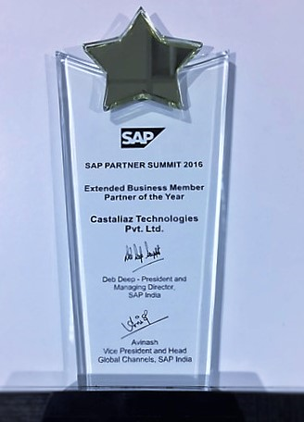
Alliance, Partner & Achievement
SAP has the largest market share for ERP globally. Castaliaz is an Authorized Reseller and Extended Business Management Partner of SAP.
SAP has awarded Castaliaz as
“Partner of the Year” in the category
“Extended Business Member”.

Slide 49
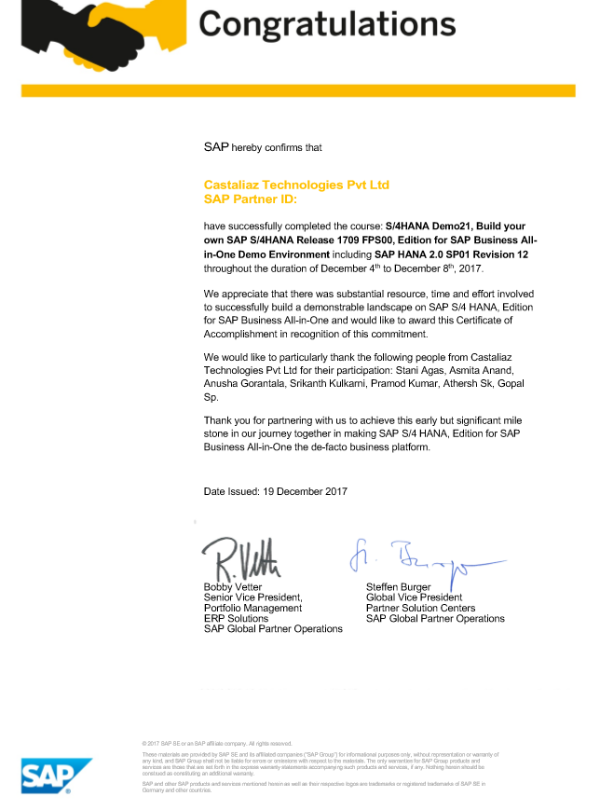
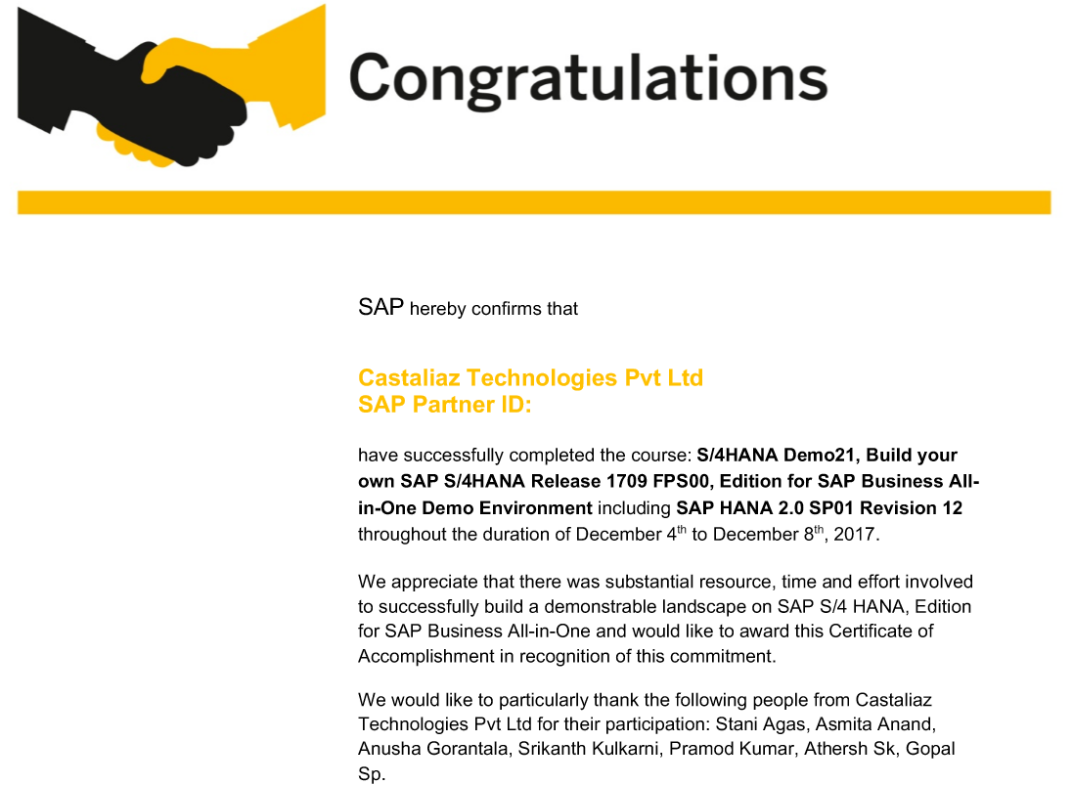
SAP S/4 HANA
Partner Recognition

Slide 50
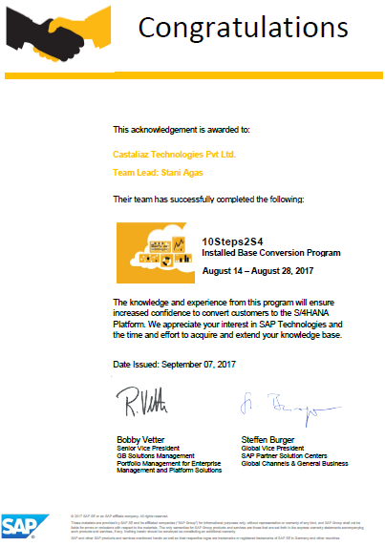
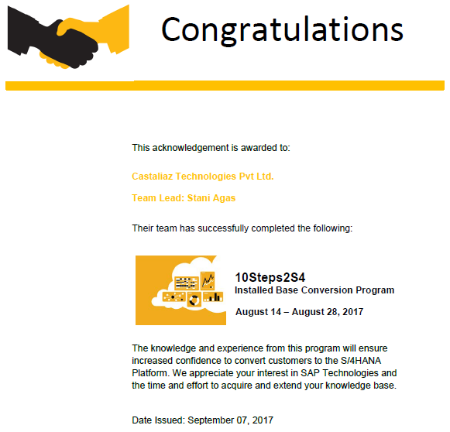
SAP S/4 HANA
Partner Recognition for migration to S/4HANA

Slide 51

GST Solution Centre

Slide 52
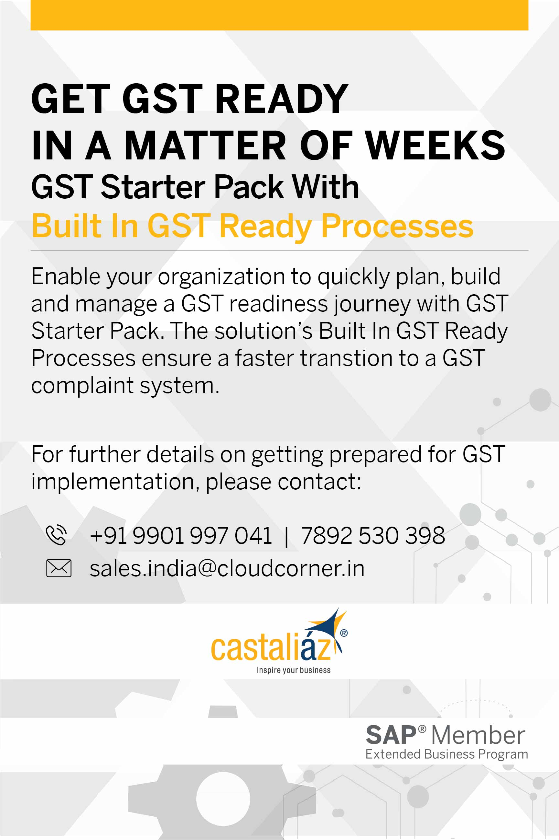
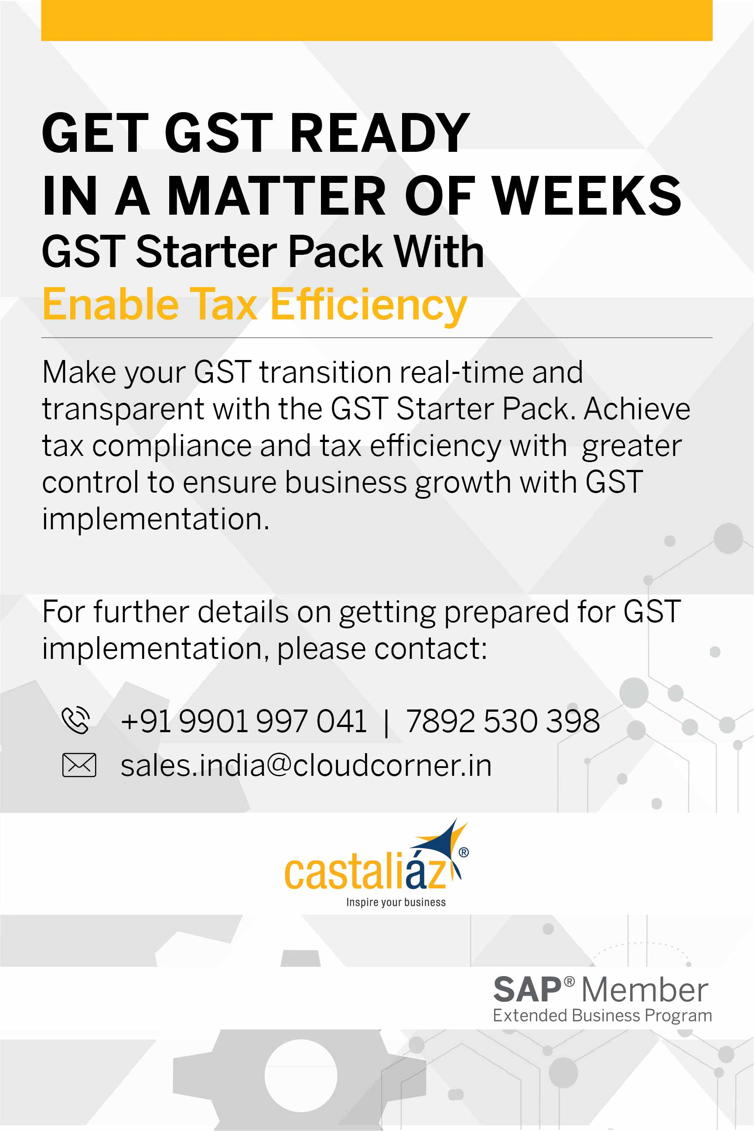

Slide 53
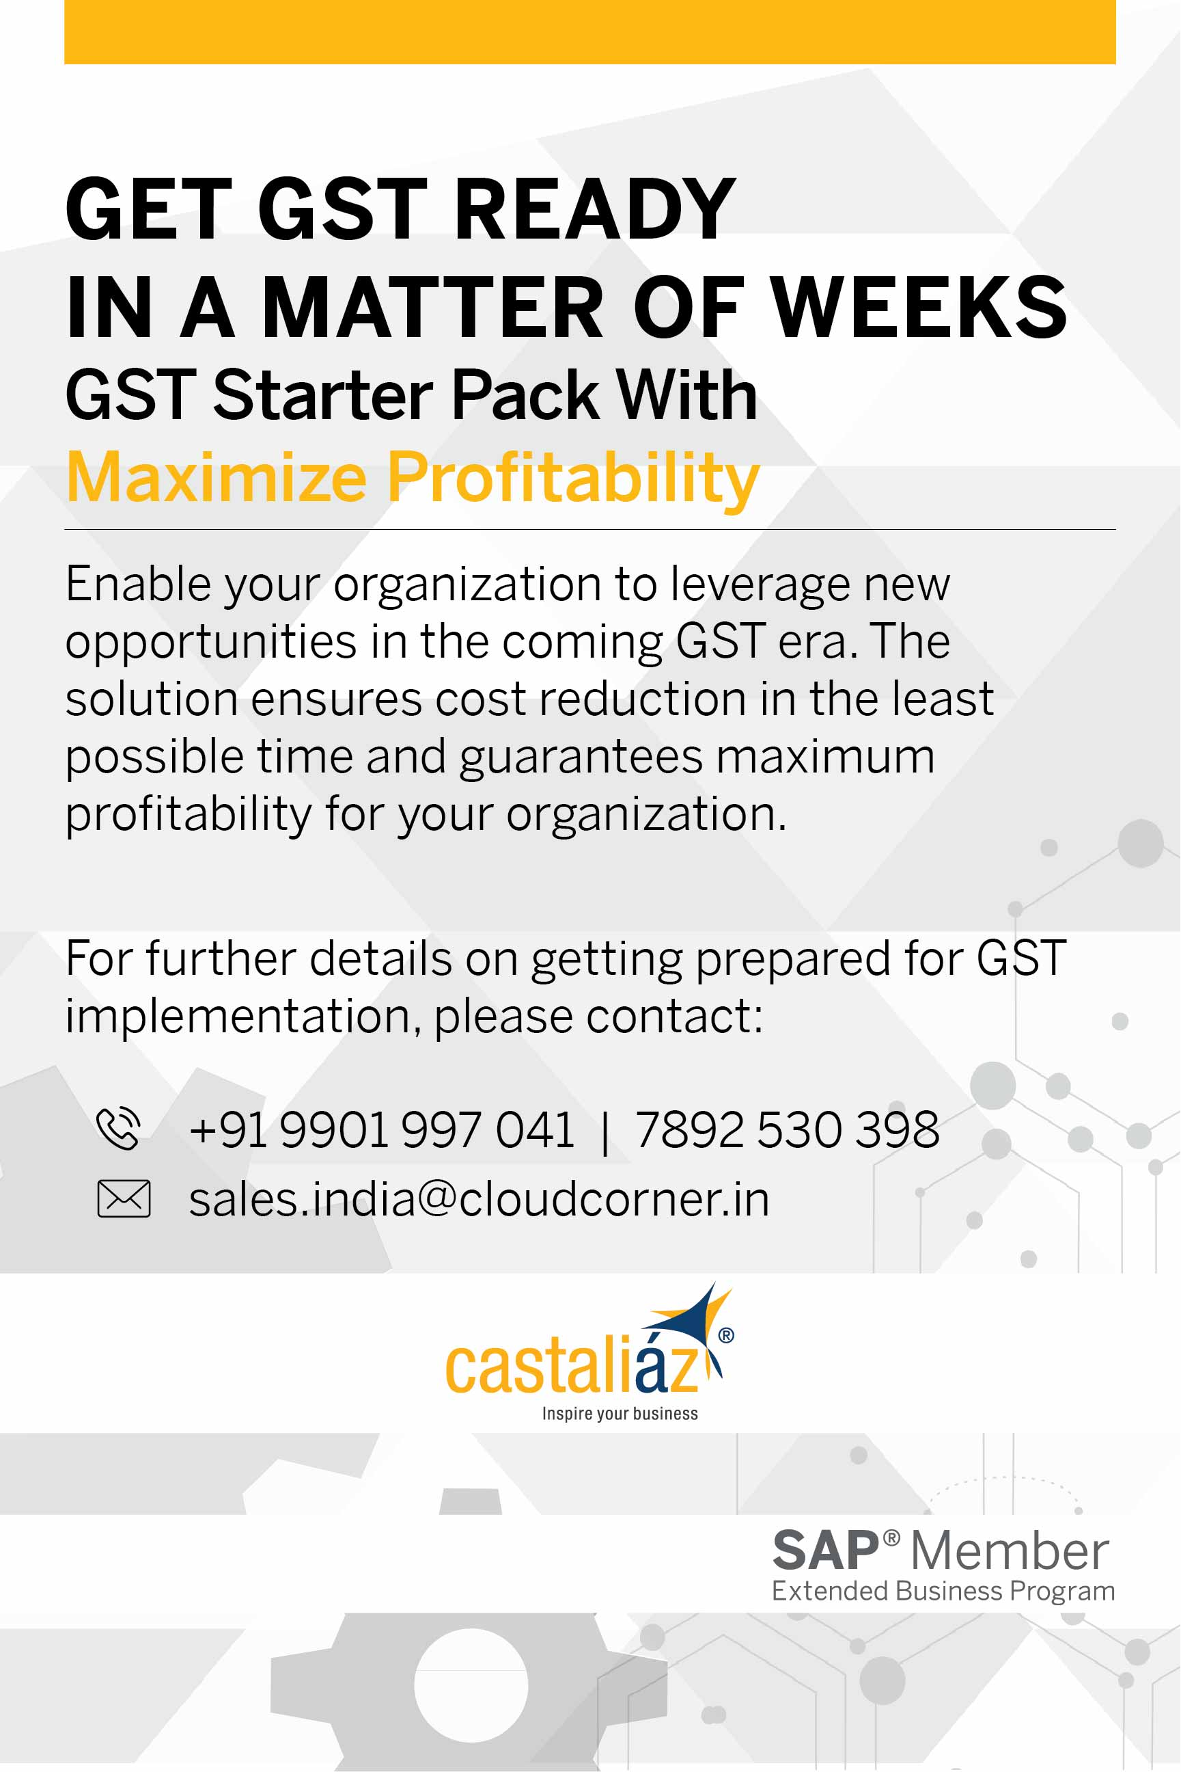
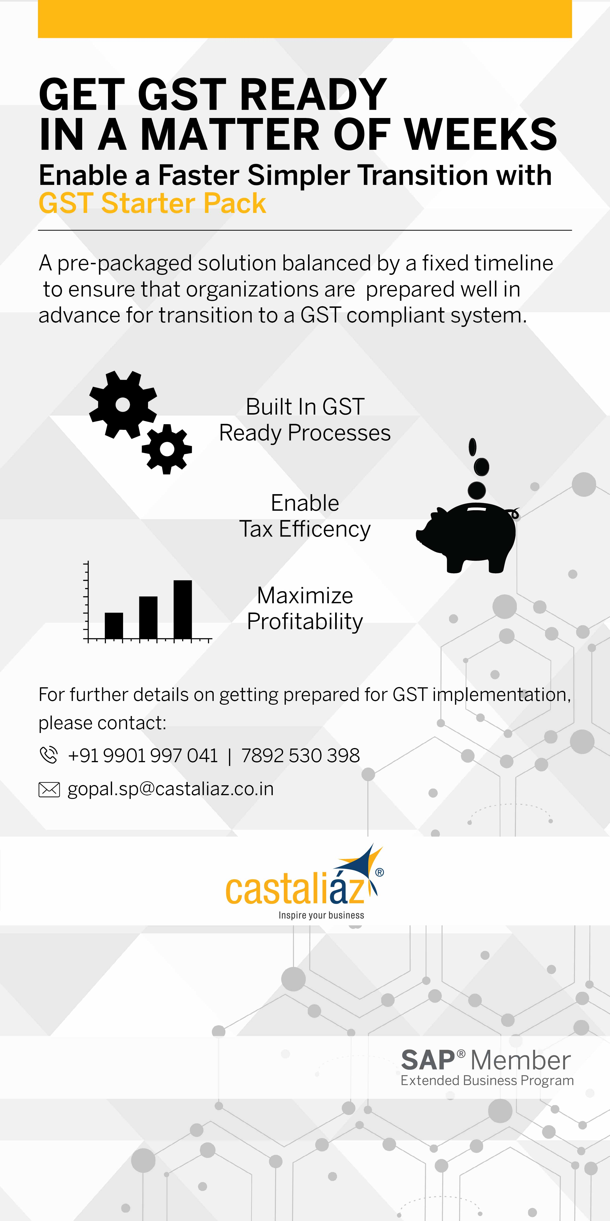

Slide 54

Contact Us
Castaliaz Technologies Private Limited
Email: info@castaliaz.co.in
Website: www.castaliaz.co.in
Corporate Office & SAP Centre of Excellence
503-504, United Business Park,
Road No 11, Plot no A-40, Wagle Estate,
Thane – 400 604, India.
Tel: + 91 22 2583 8801
Global Delivery Centre
402, 4th Floor, Momdi Business Centre
134, Infantry Road - 560 001
Bangalore, India.
Tel: +91 80 4900 6500

