Slide 1
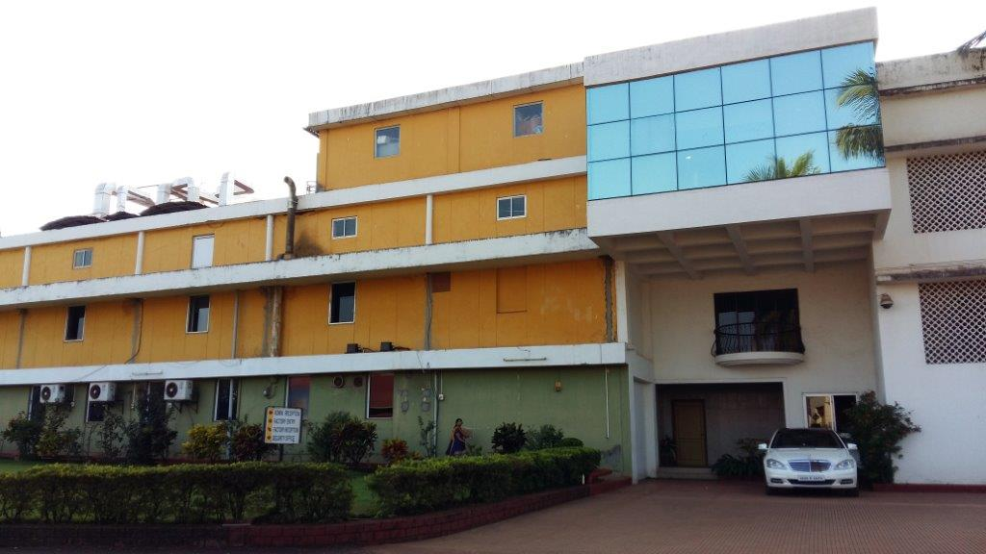
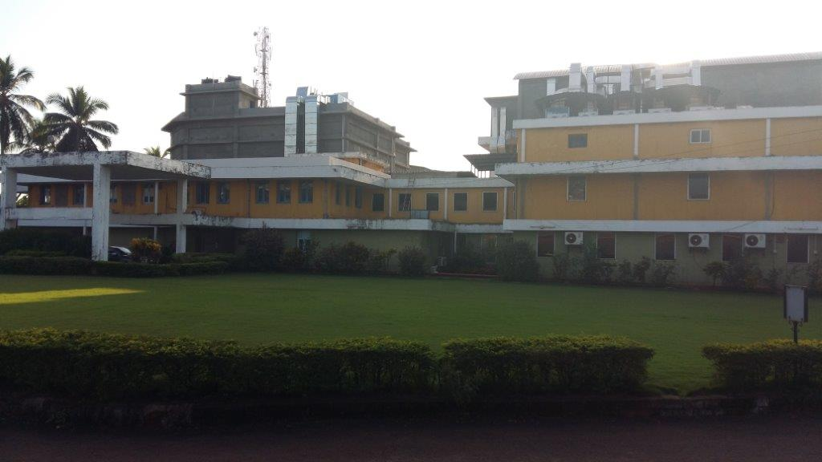
How does Geno Pharmaceuticals Monitor, Control & Improvise their Business with SAP S/4HANA?

Slide 2
Rationalizing Pharmaceutical Business Processes with SAP S/4HANA®
Geno Pharmaceuticals Pvt. Ltd. was established in December 1975. Geno is having its own formulations manufacturing facility at Karaswada, Mapusa – Goa in the picturesque environment, eco-friendly ambience of Goa on the west coast of India - roughly 600 KM South of Mumbai. Geno have taken the pledge of spreading miles of smiles across the globe through their innovative products and Quality Management System which reveals their commitment to Quality and Customer satisfaction. By implementing SAP S/4HANA in 2019, it has significantly increased efficiency by digitalizing information and integrating processes.
Before: Challenges and Opportunities
Dependency on multiple business software without integration
Establish a single version of the truth and display it in a convenient user interface accessible to all players
Maintain visibility over raw materials and product batches to meet expanding compliance requirements
Why SAP
Scalability to accommodate strong growth
Extensibility to fold in the ERP systems of global subsidiaries
Support for an upgraded Web presence to improve interaction with customers
Expertise to further leverage the Internet of Things and machine learning, as new applications emerge
Personalized support from the SAP Early Adopter Care program team
After: Value-Driven Results
Automated record keeping to increase repeatability of positive outcomes
Material and batch traceability for internal visibility and compliance with industry and government regulations
Simplified monitoring and insight delivery across functions through SAP Fiori launchpad
Tighter processes for costing of expensive product components to understand product margins
Faster response times for new orders and service issues to raise customer satisfaction
Geno Pharmaceuticals Pvt. Ltd.
Mapusa, Goa, India.
www.genopharma.com
Industry
Pharmaceutical
Products
Tablets, Capsules, Ointment & Liquid Medicines
Employees
1200
SAP® Solutions SAP S/4HANA®, SAP Fiori® and SAP Ariba ®
Modules Implemented
Financial Accounting
Controlling
Sales & Distribution
Materials Management
Production & Quality
Plant Maintenance
Project System
CSV
ARIBA
24
Depots all over India
1846
Authorized Stockists across India
54
Export Customers in 26 different Countries
“We produce medicines which help our customers to improvise their health, with the goal of products of the highest quality that improve lives and deliver outstanding value to humanity. Geno is also committed to develop more manufacturing facilities. Simply put, we aim to use SAP S/4HANA to help us raise the quality of life for posterity.”
Jayanand Aroskar, GM – IT & Compliance, Geno Pharmaceuticals Pvt. Ltd.

