Slide 1


SAP Application Management Services
Castaliaz Technologies

Slide 2
    Castaliaz Overview
    Our Understanding of the Requirements
    SAP Support Methodology & Delivery Framework
    Governance Model
    Ongoing Productivity Improvement
    Assumptions and Exclusions

Slide 3
    Castaliaz Overview
    Our Understanding of the Requirements
    SAP Support Methodology & Delivery Framework
    Governance Model
    Ongoing Productivity Improvement
    Assumptions and Exclusions

Slide 4
Executive Summary
Castaliaz Technologies Private Limited (“Castaliaz”) is pleased to respond Client (“Client”) SAP Application Support Services Request for Proposal. Castaliaz understands that Client is seeking services from an experienced & leading service provider, who shall be able to understand their business processes and deliver support to the existing application in an efficient manner.
As we understand, the scope of services includes Application Support Services across modules such as FI, CO, SD, MM, PP, PM, QM, HR and India payroll, BI/BO, ABAP & Basis Support and Support on Interfaces
  Clients Requirement
Considering the above scope and business needs of Client, Castaliaz has devised a unique response covering all the expectations as mentioned in RFP. As part of this response, we have illustrated on our:
    Time Tested SAP Methodologies & Application Support Frameworks - viz. Transition Methodology, Continuous Improvement Methodology
    Robust SAP Centre of Excellence
    India and Middle East SAP Footprint
    Success Stories in India & Middle East
    Detailed Customized Solution, supported by Various Proprietary Methodologies
Our Customized Solution enables us to provide flexible staffing in an ‘On Demand Skill’ model. This is accomplished through:
    Our strong experience in Offshore Model
    An On-Demand team of professionals from our Centres of Excellence for key skills and subject matter specialization to resolve issues expeditiously
    Our flexibility to adjust staffing during various project phases, viz. Transition Phase, Baseline Phase and Steady State Phase
    Efficient Utilization of Client’s resources during the support
    Our vast global experience which allows us to quickly create an efficient operation
  Project Approach

Slide 5

Castaliaz Overview
Pure Play SAP Firm from 2008
Executive Management Team having an average experience of 15+ years in SAP
With Lines of Business as IT Services, Business Consulting & Governance Risk & Compliance & Solutions development for specific industries
Sector Focus in Manufacturing (Discrete & Process) and Service
Strategic alliance with Enterprise Application leaders like SAP, Microsoft
SAP PE Partners (VAR) – Gold Partner
Catering to Pharma, Chemicals, Real Estate, Jewellary, Education, Engineering, Industrial Machinery, Automotive, Aerospace, Professional Services
Operating Currently from Mumbai & Bengaluru
Providing Solutions & Services to Customers in India, Europe, Middle East, Srilanka & North America
Rapid deployment solutions covering 80% of Business Solution for Industry Verticals in Chemical, Pharmaceuticals, Jewellary & Real Estate.

Slide 6
Wide Array of Solutions and Services
LOB Solutions
Customer Relationship Management
Enterprise Asset Management
Enterprise Resource Planning
Financial management
Human Capital Management
Product Lifecycle Management.
Supply Chain Management
Master Data Management
Supplier Relationship Management
Business Analytics
Analytical Applications
  Business Intelligence
  Governance, Risk, and Compliance
  Global Trade Services
Data Warehousing
Enterprise Information Management
Enterprise Performance Management
Value Consulting
Basis Optimization Services
Business Process Configuration Audit
SAP License Optimization Services
Product Costing & Inventory Valuation
Profitability Analysis
Managed Services
Operations Management
Application Management
On-Site and Offshore Support
Dedicated and Shared Resources
Full Lifecycle Implementation
Upgrades
Hardware Selection assistance
Industry Solutions
Retail
Apparel and Footwear
EC&O, Real Estate
Industrial Machinery and Components
Chemicals
Education
Consumer Goods
Pharmaceuticals & Healthcare
Jewellary
Media
Automotive
Technology
Application Foundation
    Middleware
Business Process Management and Integration
    Process Integration
Content and Collaboration
Database
Enterprise Mobility
In-Memory Computing
Rapid Deployment Solutions
RDS, an Fast-Start Solution
Flex Solution, a hosted Fast Start program
Consumer Goods, Dairy, Pharma, Real Estate, Jewellary, Chemicals
Discrete, Process and BI
Software Sales (VAR)
Digital Compliance for GST
Global Rollouts
Migration to SOH
Migration to S/4 HANA
eWay Bill Solution

Slide 7
Castaliaz SAP Credentials
Castaliaz experience with SAP stretches back to 2008.
The Castaliaz/SAP partnership has earned national recognition.
Castaliaz has successfully setup SAP S/4HANA Demo qualification, S/4HANA migration qualification.
Castaliaz was one of the certified GST Solution Center, qualified by SAP India.
Castaliaz has also taken lead role in Implementing SAP’s Solution in Digital Compliance system for its Customers and also working with Large Customers for eWay Bill Solution. Castaliaz was responsible to Run Pilot Project for DCS GSTR1 and GSTR2 and worked closely with SAP Labs Team in fixing various bugs in the solution
More than 55 percent of our SAP professionals have more than eight years of experience with the SAP software and more than 75 percent have experience across multiple modules and functional areas.
We provide our Customers with the full spectrum of SAP requisite skills to manage and deliver projects.
Award Of Best EBM Partner for 2016. This prestigious award is granted based on customers’ top ratings for acquisition of net new customers for implementation services.
Offering a comprehensive life cycle set of strategy, implementation, and leading edge technology and outsourcing solutions, we combine deep industry experience with business innovation to deploy fast, efficient, stable SAP solutions to make companies more adaptive.

Slide 8
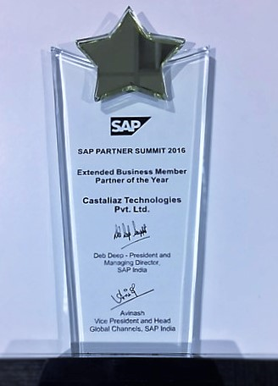
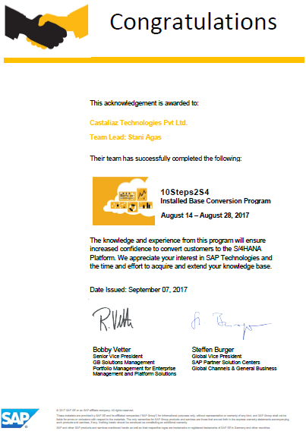
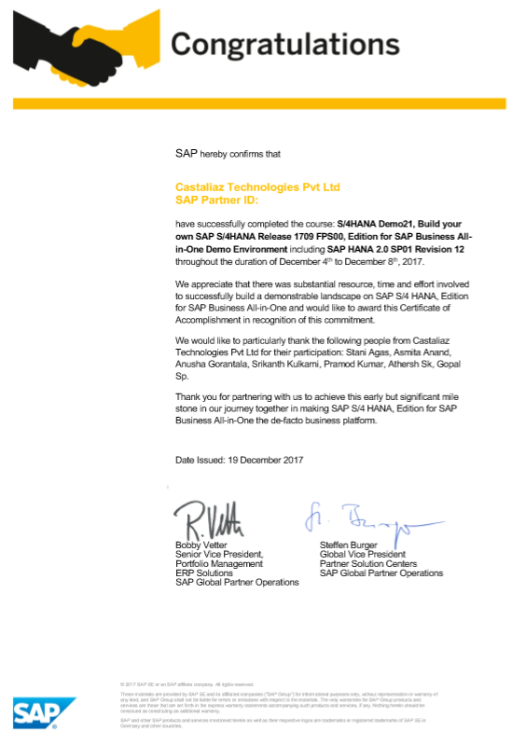
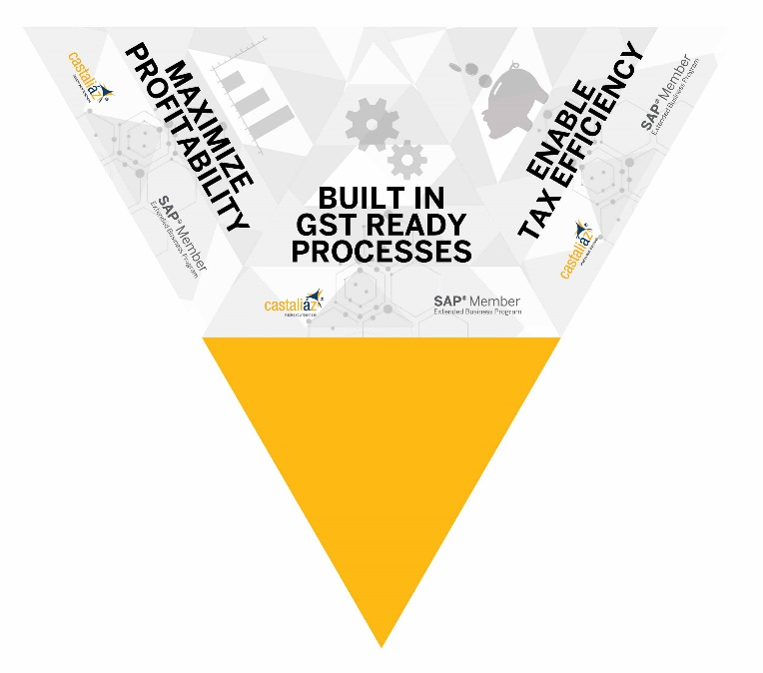
Castaliaz SAP Credentials

Slide 9
Service Snapshot

Slide 10
Service Capability Matrix

Slide 11
Delivery Capability Matrix

Slide 12
SAP Competency
Location | No of Resources
Mumbai | 65+
Bangalore | 120+

Slide 13














































Our Esteemed Clients in SAP
Aurous
+ Customers in Middle East in Retail, Construction, CPG, Pharma through our partners in ME

Slide 14

Application Management Support an Introduction
Castaliaz’s Application Support Center is structured to provide functional support of the SAP system with a program that is tailored to meet the changing needs of the business. Castaliaz is pleased to provide an overview of its capabilities and describe opportunities that may exist for cost savings and improved service levels.
Application Support includes multiple levels of
support including user training, application configuration
and development, and other basic “fix-it” solutions.
This can be a combination of remote and/or onsite
staff to support the business and the application
environment in solving problems and extending the
functionality of SAP.
Process improvement activity and functional
enhancements are included in our offering.
Our field team can be engaged for larger
enhancement projects requiring full time,
onsite attention.

Slide 15
Application Management Support an Introduction
Castaliaz’s application support Team makes the difference.
Location
  Offices support is available from Mumbai and COE in Bangalore
  Sales Offices in Gujarat and Chennai.
Experience
  Senior level consultants with 7 to 12 years SAP, 15 years business experience on the core team.
  Experience as customer and as consultant and have implemented several onsite projects as well as working in support.
  Experience in handling multiple industry sectors
  Our SAP knowledge extends to all core areas required in a comprehensive application environment (e.g. Financials, Controlling, Logistics, Manufacturing, Human Resources, etc.)

Slide 16
Application Management Support Overview
Un-matched SAP Consulting Expertise
  As Application Support Partner, Client is enabled with the capability to manage its SAP landscape for its life-cycle adding significant values through:
    Enhancements that eliminate recurring issues and simplify user interactions
    Practices and solutions that Castaliaz has acquired while delivering SAP consulting services to similar Client
    Access to Global/Local expertise to enable constantly changing business needs
Proven Processes & SLA-driven Delivery
  We have proven, ITIL complaint processes, infrastructure to monitor and review of our service delivery as per the agreed SLAs and Norms
Increasing Business Value
  Our Application Support Services constantly add value through enhancing the implemented solution, providing operational knowledge to the users’ and improve the service quality by leveraging our global experience with similar Client
Flexible Resourcing Model
  Our flexible support agreements can be tailored to the ever changing needs. We provide SAP support consultants located out of centralized delivery-centers, which are Mutualized across SAP Support Customers, allowing us to offer the exact SAP Support Capacity to the Client
Right Skills to cover the complete AM Scope
  A one-stop SAP skill-set partner, focusing on dynamic business requirements by providing value adds to eliminate any recurrence

Slide 17
SAP Service Offerings
SAP Application Management
  This is primarily the SLA-based support and maintenance of SAP applications. It covers the entire spectrum of Corrective maintenance (break/Fix), Preventive maintenance, Adaptive maintenance (enhancements)
SAP Run
  Castaliaz takes full responsibility for customer’s SAP applications, infrastructure and service processes at a scalable cost
SAP Testing Services
  Delivers functional and performance testing to help reduce ongoing running costs and improve the ongoing reliability of applications
SAP System Management
  Transport Management, User Authorization, Profile Generation
SAP Skills on Demand
  Provides access to a spectrum of application outsourcing skills including development, test and maintenance resources as well as business analysts, transition managers and project managers sourced via a combination of Onsite and Offshore resources
SAP Training Services
  Documentation, Training/Help Manuals, Role Based Training for all types of users
SAP Upgrade Services
  Migrating to the newer versions of SAP
SAP Rollout Services
  Template based Global rollouts

Slide 18
Castaliaz Offers Services Covering the Complete Application Services Lifecycle
Transition
Development & Maintenance
Transformation
Transition
Corrective Maintenance & Application Enhancement
Adaptive Maintenance
Application Renovation
Transformation
Transition Planning
Knowledge Acquisition
Knowledge Assessment
Gap Analysis
Knowledge Retention
Day to day maintenance of the system
Enhancements
Patches
Upgrades
Continuous Improvements through Delivery Accelerators
Technology
Functionality
Regional vs. Global
T o o l s
P r o c e s s e s
M e t r i c s
T e m p l a t e s

Slide 19

    Castaliaz Overview
    Our Understanding of the Requirements
    SAP Support Methodology & Delivery Framework
    Governance Model
    Ongoing Productivity Improvement
    Assumptions and Exclusions
    SAP DCS Discussions and DEMO

Slide 20
Our Understanding of the Requirements
Organizational Structure Elements | Quantity
Company Code | Client Name
Country | India
Geographical Scope | Pan India
Purchasing Organization | One Purchasing Organization per Division
Sales Organization | One Sales Organization per Division
Controlling Area | 1 Controlling Area per Division
Operating Concern | 1 Operating Concern per Division
Chart of Account | 1 Operating chart of account per Division
Ledgers | One Leading Ledger per Division
Currencies | INR
Project Location (Onsite) | India,
Project Location (Offshore) | Castaliaz Office (Mumbai, Bengaluru and Chennai)
This is a sample

Slide 21
Our Understanding of the Requirements
Organizational Structure Elements | Quantity
Modules Implemented | Financial Accounting Controlling Sales & Distribution Materials Management Production Quality Management Human Resource India Payroll
Analytics | BI / BO
GST Compliance | SAP DCS (Not yet Live)
Support Scope | Level 2, Level 3 and Level 4 issue Resolution
Support Activities | Help Desk ticket logging and Resolution of User Queries SAP Techno-Functional Support Resolution of Bugs Coordination with SAP for Bug Fixing, Issue Resolution Statutory Note application Documentation for Issues resolved

Slide 22
Our Understanding of the Requirements
Organizational Structure Elements | Quantity
Support Activities | SAP Functional Support Existing Enhancements, Existing Report Development, Training on enhanced scenarios and User Manual for enhanced processes. Configuration Modification as per Business Need or due to changes with respect to statutory requirements Enhancements of new processes in modules implemented Minor Enhancements New functional enhancements, New Report Development SAP General Notes and Patch Application as required End user support and training if required Month end and Year end support for Dispatches, Accounts closing, Payroll processing etc SAP BI Integration with ECC SAP Integration with other business applications Email & SMS integration SAP Solution Manager Support & EWA Reporting (SAP Health Check including Patch update, Reports performance) Implementation of Budgetary changes proposed by the Government

Slide 23
Our Understanding of the Requirements
Organizational Structure Elements | Quantity
Support Activities | SAP Technical Technical support will be ABAP & BASIS For ABAP, the activities will be: Understand the requirements, detail out the technical-specification, develop and unit-test the programs and release for production after users’ acceptance Review the existing programs (key ones) and wherever required optimize the codes/logics to improve the performance and users’ experience Basis Activities SAP Support on BI/BOBJ issues
Scope Exclusions | Any major enhancements/Roll-outs including Upgrades; Major Enhancements (>80 hrs) Such activity will be taken up through Change Control Procedure. Change Control Procedure will detail out enhancement, the implementation options and their impacts, recommended option along with additional efforts and related cost; the actual implementation will be taken up after appropriate approvals and mutual agreement

Slide 24
Our Understanding of the Requirements
Organizational Structure Elements | Quantity
Support Window | 09:00 Hrs to 18:30 Hrs IST from Monday to Saturday Emergency support on critical activities on Sundays & holidays if required Consultants to be available for on call support for after office-hours support and support on Public & Bank Holidays
SLA

Slide 25
    Castaliaz Overview
    Our Understanding of the Requirements
    SAP Support Methodology & Delivery Framework
    Governance Model
    Ongoing Productivity Improvement
    Assumptions and Exclusions
    SAP DCS Discussions and DEMO

Slide 26
Support Solution Delivery Phases
SAP Application support will have 3 distinct phases:
Transition Phase (2 Weeks)
  The Transition duration will be of 1 to 2 weeks which will focus on smooth transition
  Transition will be carried out from Client office in Kalina
Base-lining Phase (1 Month)
  Base-lining Phase will ensure stabilizing on established tools, procedures and processes along with re-alignment of SAP applications to steady-state support. SLAs will be established during this period
Steady-state support Phase (10.5 Months)
  Weekly/Monthly reports and quarterly reviews
  Steady-state Phase will focus on productivity gains, improvements and innovation-led transformation
Castaliaz proposes the following approach to reach the steady-state of supporting the application:
Transition Phase (2 Weeks)
Base Lining Phase (1 – 2 month*)
Steady Phase (2 – 12 months)
Discovery & Planning Phase
Transitioning of Support Activities
Castaliaz Support
Identify Continuous Improve-ments
Actionize Improve-ments
Prepare
for
Steady State
Cost-
Optimization
Ticket Reduction
Quarterly Review
  * Considering Client SAP System as Medium Complex implementation.

Slide 27
Castaliaz Support Solution – Transition Phase
Transition Phase (0–1 Month)
Base Lining Phase (1 – 2 Month)
Steady Phase (2 – 12 Months)
Planned Activities
    On-board Transition-team, Meeting with Client team
    Client to provide access to existing solution /configuration documents
    Understanding of implemented SAP solution, wherever required get trained and Identifying Complexities and Risks
    Analyse the issues
    Document the understandings
    Establish support procedures and methods
Discovery & Planning Phase
Transitioning of Support Activities
Parallel Support
    Joint Team of Castaliaz and Client
    Understand existing Support Process
    Identify Complexity and Risks
    Establish Scope & Expectations
    Develop detail plan for transition, stabilization and Steady State
    Detail understanding of application and support process
    Begin formal knowledge transfer
    Establish support process and SLA metrics
    Acquire knowledge on applications and gets trained on support process
    Work Shadowing & Parallel Support Activities
    Cutover and Steady state transitioning
Methodology/Best Practice
    Transition Methodology
      Due Diligence
      Discover
      Transition Execution
      Handover to ongoing delivery
      Transition Closure
Client Contribution
    Provision of access to the documentation
    Arranging meeting with core-team and current support partner for Knowledge sharing sessions
    Access to SAP Applications

Slide 28
Transition Work Stream and Key Deliverables
Transition Work Stream | Key Deliverables
Transition Governance | Project Governance Plan (PGP) Risk/Issue Register Detailed Transition Plan Progress Reports – Weekly Status Report
Staffing | Staffing Plan
Knowledge Transfer | Knowledge Acquisition Plan Application Overview Document
Financial & Contractual | Licensing & operating level Agreements
Service and Project Take-on | WIP Projects List Report Service Impact Report

Slide 29
Castaliaz Support Solution – Baseline Phase
Transition Phase (0–1 Month)
Base Lining Phase (1 – 2 Month)
Steady Phase (2 – 12 Months)
Planned Activities
    Stabilize on established methods, tools and procedures
    Analyze open issues and identify improvement opportunities
    Prioritize improvements, Discuss and Finalize the identified improvements with Client
    Begin implementing improvements as per the finalized plan
    Set SLAs and Refine support procedures
Identify Continuous Improvement
Actionize Improvements
Prepare for Steady State
    Castaliaz Support to identify Continuous Improvement Opportunities
    Support team to propose improvements plan and finalize with Client
    Productivity Gains
    Prepare FAQs and help-documents
    Periodic health-checks
    Higher System Availability
    Set SLA targets and begin day-to-day support
    Refine Service Delivery Process
Methodology/Best Practice
    SLA framework
    Continuous improvement
    Project Governance
Client Contribution
    Participate in Review process
    Users’ acceptance of implemented improvement actions
    Formalizing SLAs
    Provision of infrastructure to Castaliaz Support team

Slide 30
Castaliaz Support Solution – Steady State Phase
Transition Phase (0–1 Month)
Base Lining Phase (1 – 2 Month)
Steady Phase (2 – 12 Months)
Planned Activities
    SLA –based SAP support services
    Implementation of improvement initiatives
    Measurement of Support Effectiveness through
      Ticket reduction
      Enhanced users’ experience
      Productivity improvement
    Conduct Innovation workshop once every quarter; Identify innovation-led transformation initiatives
Quarterly Review
Ticket Reduction
Optimize Support
    Meeting Conducted to monitor and review the progress of the project
    Start realizing benefits of teaming with Castaliaz Support team for Support
    Cost reduction through
      Better Support Process & SLA Management
      Ticket Reductions
      Productivity Improvements
    Castaliaz Support will continuously deliver value to identify through support process
    Castaliaz will notify cost-reduction opportunity and reduction if any
Methodology/Best Practice
    Support Review Framework
    Innovation workshop
    Reports and actions
    Review mechanisms (weekly/Monthly/Quarterly calls)
Client Contribution
    Participate in Review process
    Participate in Innovation workshops
    Provision of infrastructure to Castaliaz Support team

Slide 31
Delivery Transition to Castaliaz
SAP System Landscape Assessment & Verification
Document Business Drivers &Challenges, Broad-level Business Processes of customer
Prepare SAP Landscape Document with interfaces to external system and infrastructure overview
Prepare SOW, Deliverables, Resource requirements, Quality & Service Level requirements
Off-shore Feasibility Analysis, Transition Complexity Analysis, Risk assessment
}
}
}
}
Solution Proposal & Finalization
Finalize Resource & infrastructure requirements; Evaluate Engagement Models
Propose Delivery models, Service level Mgmt, Risk mitigation plan, Project plan, Delivery Management Tools & software, Transition Plan, Tech Recommendations, Project governance & Processes
Propose commercial structure, pricing, contract; negotiations and finalize contract
}
}
}
Knowledge Acquisition Planning & Preparation
Identify Knowledge, Sources of Knowledge & resources to transfer knowledge across TAB*
Finalize KT Documents & Castaliáz resources for knowledge acquisition
Finalize infrastructure, Prepare Knowledge, Transfer Plan, Customer Approval
}
}
}
TAB* - Technology, Application & Business
Knowledge Acquisition
Castaliázteam understands Technology, Business & Applications of Customer
Simulate on-site / off-shore environment; Test Low priority & less intensive apps
Analyze Service Level Metrics and Identify Improvement Areas
Update Solution Manager
}
}
}
Delivery Transition To Castaliaz
Customize Quality Management System; Training & Knowledge Transfer to Off-shore / other teams; ODC setup and initiate operations, Pilot Project Execution
}
Onsite : }
Offshore : }
Either or Both : }
Service Level Monitoring
Metrics SLA based delivery; Testing Applications; Continuous Improvement through Analysis, Optimization & Automation
}
Continuous Process Improvement
Preventive Maintenance, Root Cause Analysis, Team rationalization, Service Level Reporting
}

Slide 32
Delivery Framework
Quality processes
Castaliáz Program Management Office
Reusable Assets
Project
Management
Procedures
Delivery Director
Program Managers
QA Managers
Onsite Delivery
Offsite Delivery
Customer
Castaliaz
(Back-Office)
Customer Engagement
Manager
Delivery Management Tools
SAP Solution Manager, Proprietary Issue Tracking & Billing System
Delivery Manager
QA Manager
Castaliaz
Customer
Process Owners
Delivery Manager
Delivery Team
Status Reporting
Customer
End Users
Delivery Team
Daily Review Session
Weekly Status Report
Monthly Status Report
Milestone Delivery Report
Exception Report
Activities
Activities
Issue Ticket Acknowledgement, Allocation, Analysis, Effort Estimates & Feedback, Prepare related Business Process Procedures, Configuration on SAP Systems, Prepare Testing Scenarios & Scripts, User Manuals, related Data Migration, User Feedback, Corrective Actions, Documentation, Issue Closure
Issue Ticket Acknowledgement, Allocation, Analysis, Effort Estimates & Feedback, Prepare related Business Process Procedures, Configuration on SAP Systems, Prepare Testing Scenarios & Scripts, User Manuals, related Data Migration, User Feedback, Corrective Actions, Documentation, Issue Closure
Communication Tools
SKYPE Audio Conferencing & Video Calls, Periodic Visits
E-Mail

Slide 33
Issue Resolution Process
Issue Resolution Phases
Support Ticket Management
Realization
Testing and Transport
Training
Closure
Support Ticket Creation by Customer
Provide detailed Business Requirement document
Ticket Acknowledgement
Ticket Allocation to Consultant
Ticket Analysis, Queries & feedback
Issue / Process Documentation
Sign-off Issue Documentation
Effort Estimates & Feedback
Design Documentation
Prepare Functional Specs & Technical Specs
Perform Configuration on system
Development on system
Prepare Configuration Document
Prepare Test Scenario & Scripts
Perform Unit & Integration Testing
Record Test Results & Provide feedback
Rectify defects / Incorporate feedback
Re-Testing
Testing Signoff
Transport from Test Environment to Quality
Perform Testing as above
Confirm Results
Transfer to Production
Prepare Training Manual
Train End Users
Provide Training Evaluation & Feedback
Retrain, if required
Training Signoff
Issue resolution
Prepare Closure Documentation
Ensure Issue Closure
Ticket Signoff
Close Ticket
Customer : }
Castaliaz : }

Slide 34
Ticket Management Workflow
Receive Ticket /
Acknowledge
Ticket created and assigned
by Client (L1 – Client)
Reassigned
to Client
Level 2 Support
Problem
Or Maintenance
Fix (L3)
Adhoc
support
requests
N
N
Y
N
Y
Y
Analysis of Problem
for Workaround
Analysis for all
related incidents
Analyze the
problem request in
consultation with
SME
Obtain approval
for Workaround
Provide Estimates
& get approval
Provide UAT
support
Y
N
Create CR
& get approval
Test & Implement
Workaround
Prepare CR
documentation
Provide Solution
and monitor
Close Ticket
Approve
Problem
Solved?
Provide
Release support
N
Y
Perform RCA
for the problem
Perform reviews
Monitor Release
Y
Perform Level 2
Testing
Update Knowledge
Base
Implement
Corrective Action
Close Ticket
Perform UAT
Close Ticket
Update Knowledge
Base
END
Client
Castaliaz

Slide 35
Service Level Management
Service level Management
A proactive methodology with procedures to govern the Delivery Management and ensuring that adequate levels of Service agreed with the Customer are met while providing AMS
SERVICE LEVEL AGREEMENT
Project Governance Structure, Roles & Responsibilities & Workflow in the above structure
Quality Expectations of the Customer
Response Times & Resolution times agreed with the customer - IRT and MPT for customer messages, depending on the priority assigned
The procedure to follow if the customer message cannot be solved within the prescribed time
Escalation Levels
Service Windows
Resource Deployment – (by skill, on-site / off-shore ……)
Service level Definitions
Defining the quality of Application Management Services provided to the customer
Service level Reporting
A measurement of Service Levels of Application Management Services provided by Castaliaz

Slide 36
Solution Manager
SAP Solution Manager used in ……….
SAP Implementation / Rollouts
SAP Upgrades
Solution Development on SAP
Application Management Services
Implementation Content
Project Management
Managing Business Blueprint
Project Planning
Central Test Coordination
Training
Customizing Synchronization
Upgrade Content
Customizing Sync
Upgrade Management
Upgrade Blueprint
Infrastructure Mgmt
Central Test Coordination
Training
Best Practice Documentation
Project Management
Project Planning
Design
Infrastructure Mgmt
Central Test Coordination
Training
Change Request Management
As Primary Support Desk Tool
Support Ticket Mgmt.
Early Watch Alert & Service Level Reporting
System Monitoring & Administration
Business Process & Interface Monitoring
Change Request Mgmt.
Project Management Tool for all SAP Service Offerings
Customer Message Processing / Status Tracking
SAP Service Market Place/SAP notes/Sap Patch Downloads

Slide 37
Proposed Service Level Agreement
Ticket category | Respond | Resolution | Business hours
P1 | Immediate | 4 – 8 hours | Normal business hrs
P2 | 30 Minutes – 1 Hours | 24 hours | Normal business hrs
P3 | 4 hours – 6hours | 48 hours | Normal business hrs
P4 | 8hours | 96 hours | Normal business hrs
Severity 1 (Critical) | Severity 2 (High) | Severity 3 (Medium) | Severity 4 (Low)
Business and financial exposure
The application failure creates a serious business and financial exposure | The application failure creates a serious business and financial exposure | The application failure creates a low business and financial exposure | The application failure creates a minimal business and financial exposure
Work Outage
The application failure causes the Client to be unable to work or perform some significant portion of their job | The application failure causes the Client to be unable to work or perform some significant portion of their job | The application failure causes the Client to be unable to perform some small portion of their job, but they are still able to complete most other tasks. May also include questions and requests for information | The application failure causes the user to be unable to perform a minor portion of their job, but they are still able to complete most other tasks
Number of Users Affected
The application failure affects a large number of users | The application failure affects a large number of users | The application failure affects a small number of users | The application failure may only affect one or two users
Workaround
There is no acceptable workaround to the problem (i.e., the job cannot be performed in any other way) | There is an acceptable and implemented workaround to the problem (i.e., the job can be performed in some other way) | There may or may not be an acceptable workaround to the problem | There is likely an acceptable workaround to the problem

Slide 38
Support Level Definitions
Helpdesk & L1 will be supported by Client/Castaliaz Team & Castaliaz will support all L2 & L3 tickets.
1
2
3
Level 1 Support
Client Help Desk
Level 2 Support
Castaliaz Team
Level 3 Support
Castaliaz Team
First point of contact for users
Incident recording and alerting
Incident categorization, Investigation and diagnosis
Confirm closed Tickets
Provide resolutions to known issues
Resetting Passwords and resolve access problems via security lists
Define/authorize SAP User Ids
Notify All users of unscheduled downtime/availability problems
Update knowledge repository with latest documentation
Addressing functional queries related to setups
Interact with Client SMEs as and when required, to resolve issues
Identify / Analyze process problems
Break-Fix
Service Level Management
Break- Fix
Code changes to resolve issues
Change Requests and Enhancements to be implemented
Manage knowledge repository and FAQs
Manage and monitor process schedules
Support Documentation
Preventive maintenance
Review any changes to batch schedule for technical impact
After-hours Support
Support Documentation

Slide 39
    Castaliaz Overview
    Our Understanding of the Requirements
    SAP Support Methodology & Delivery Framework
    Governance Model
    Ongoing Productivity Improvement
    Assumptions and Exclusions
    SAP DCS Discussions and DEMO

Slide 40
Project Governance Model
Strategic Leadership
Strategies
(Long term plan)
Business Guidelines Contract
Account Executive
Project Sponsor
CIO
Executive
Team
Service Delivery Director
Business Process
Owners
Tactical Leadership
Service Review
Service Scope Change
Demand Management
Projects Prioritization
Service Delivery Director
Delivery Manager
Steering
Committee
Steering Committee
Application Project
Managers
Client Project
Manager
Operational Leadership
Service Delivery Manager
Lead Analysts
Operational
Team
Change Management
On going service
Application SMEs
Onsite & Offshore
Consultants

Slide 41
Proposed Team Structure
Steering Committee
(Castaliaz + Client)
Engagement
Manager
Client Project
Sponsor
Project / Transition
Manager
Client Project Manager
Technical
Lead
Functional
Lead
Business Process Owners
Core Team
Technical
Consultant
Functional
Consultant
Key End Users
Technical
Consultant
Functional
Consultant
IT Team
Castaliaz
Client

Slide 42
Issue & Escalation Management
Escalation Process
Issue Type
Escalation Point
Escalation Criteria
Governance Role
Project Delivery
Castaliaz Service Delivery Manager
If plan to resolve issue is not outlined within 48 hrs (24 hrs in case of urgent issues)
Weekly checkpoints (or depending on the urgency)
Issue resolution
Quality issues
Unresolved delivery issue
Program Management issue within specified timeframe
Castaliaz Engagement Director
If plan to resolve issue is not outlined within 96 hrs (48 hrs in case of urgent issues)
Monthly Review
As needed in case of urgent issues

Slide 43
    Castaliaz Overview
    Our Understanding of the Requirements
    SAP Support Methodology & Delivery Framework
    Governance Model
    Ongoing Productivity Improvement
    Assumptions and Exclusions
    SAP DCS Discussions and DEMO

Slide 44
On Going Productivity Management
Applications Developments & Maintenance
Maintenance
Preventative, Incident Management,
Corrective, Problem Resolution
Enhancements
Requirements, Design,
Build & Test, Deploy
Development
Requirements, Design,
Build & Test, Deploy
Service Management
Enablers
Experienced Senior Team
Distributed Delivery
Depth of Sourcing
Mutualization of Resources
Industrialized Tools & Processes
DELIVER Methodology
Continuous Improvement Process
Problem
Management Tool
Service Reporting
Code Analysis,
Test coverage
KT Tracker
Knowledge Management Tool
Improve Service Levels
Increase Availability
Reduce Costs

Slide 45
    Castaliaz Overview
    Our Understanding of the Requirements
    SAP Support Methodology & Delivery Framework
    Governance Model
    Ongoing Productivity Improvement
    Assumptions and Exclusions
    SAP DCS Discussions and DEMO

Slide 46
Assumptions
Infrastructure Assumptions
The network and connectivity will be set-up by Client for accessing their network for supporting the applications not covered under this Proposal
Client Team provides all Infrastructure Support or Management services (IM) for these systems covering server, platform, database and user administration/ profile creation/ security support. These activities are specifically excluded from the scope of work of the Application Support
Network Connectivity between Client and offshore location to be established and tested before the commencement of Shadowing sessions
Client network has sufficient bandwidth and stability to establish reliable connectivity to the application and associated application support tools with acceptable response times
All application data (code, database, etc.), and application support tools reside on the Client network and supported systems
Client will provide facilities for onsite Knowledge transfer team.

Slide 47
Exclusions
Geographical Scope and User base supported – Application support services will be provided for Client’s applications mapped to their current SAP system
Modules / Products which have not been indicated in the scope section above will not be a part of support services under Castaliaz’s proposal
Castaliaz will liaise with SAP in order to resolve any product related issues on behalf of Client; however the resolution of these issues will be SAP’s responsibility not Castaliaz’s
Castaliaz will not manage any other third party software and relationships
Organizational Change Management (OCM) is out of scope
Data collection, Data cleansing, Data Validation, Data reconciliation & Data Upload is out of scope.
Any form of Organizational Restructuring or Redesign is out of scope and will be considered as a Change Request or New Project.
Any form of Organizational Hierarchy / Chart design or redesign
Any other business or IT consulting, other than those proposed in this proposal
OSS connectivity will be provided by Client
Castaliaz is not providing Client with legal, financial or regulatory advice. To the extent applicable to any of the services, Client shall consult with and rely exclusively on its own legal counsel and financial representatives for advice

Slide 48
    Castaliaz Overview
    Our Understanding of the Requirements
    SAP Support Methodology & Delivery Framework
    Governance Model
    Ongoing Productivity Improvement
    Assumptions and Exclusions

Slide 49
Contact Details
Castaliaz Technologies Private Limited
Email: info@castaliaz.co.in
Website: www.castaliaz.co.in
Corporate Office & SAP Centre of Excellence
503-504, United Business Park,
Road No 11, Plot no A40, Wagle Estate,
Thane – 400 604, India.
Tel: + 91 98202 44162 / 022 25838801
Global Delivery Centre
402, 4th Floor, Momdi Business Centre
134, Infantry Road - 560 001
Bangalore, India.
Tel: +91 80 4900 6500

